Slide 1
SESSION #: S2:08 Need a report? Escape can do that!
Date: February 17, 2021
Time: 12:50 PM – 2:20 PM
Presenters: Stephanie Dirks & Shannon O’Reilly

Slide 2
Housekeeping Items
Thank you for attending
This session is being recorded
Please kept yourself on mute unless you are speaking
This presentation is intended as an open conversation, please feel free to ask questions throughout the presentation.

Slide 3
Agenda
A Budget Code Story
Running Reports
Top Three FAQs
Budget Transfer
Expenditure Transfer
Linking A code
Types of Reports
Report Favorites
Auto Email Report
General Q&A
General Escape or Accounting questions

Slide 4
A Budget Story
Every component tells a part of the story
Fund – almost all are Fund 10 – General Fund
Location – physical location of where the funds are being spent
Responsibility – Who oversees the funds - Dean, VP
Programs that start with a 1XXX are Categorical
Programs that begin with any other number are District
Activity Codes – state mandated, gives more information about the use of the funds
Object Code – defines the type of expenditure
4390 – supplies, 1430 – associate allied, 5210 – staff travel

Slide 5
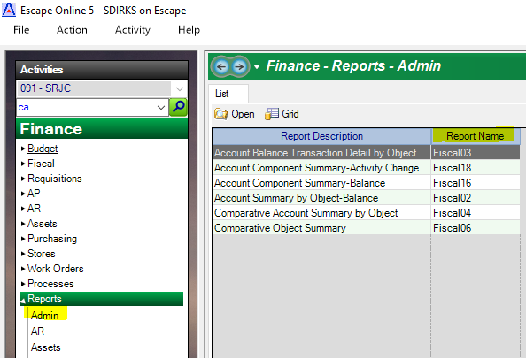
Fiscal Reports
Fiscal 03
Account Balance Transaction Detail by Object
Fiscal 02
Component Summary – Balance
Fiscal 04
Comparative Account Summary by Object
Fiscal 16
Account Component Summary - Balance
Fiscal 06
Comparative Object Summary

Slide 6
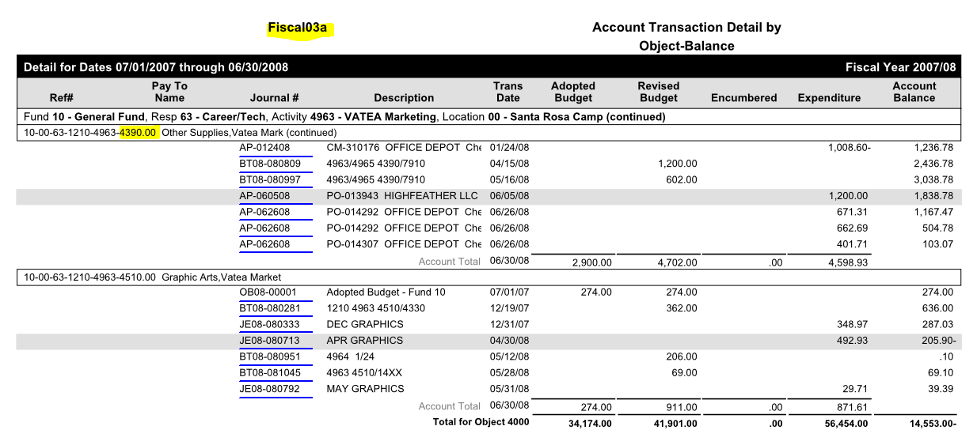
Fiscal 03 Account Transaction Detail by Object - Balance

Slide 7
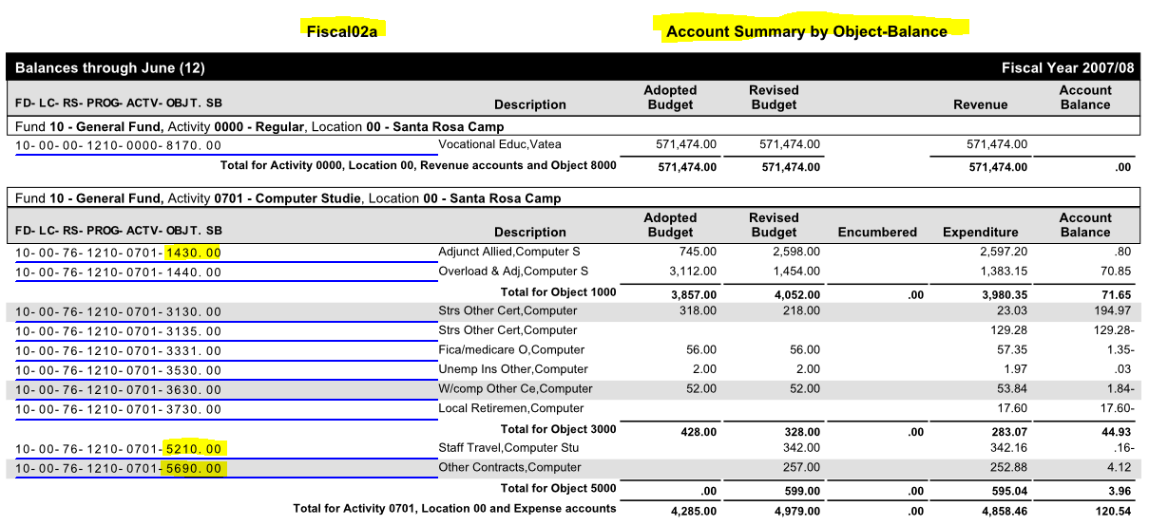
Fiscal 02 Component Summary – Balance

Slide 8
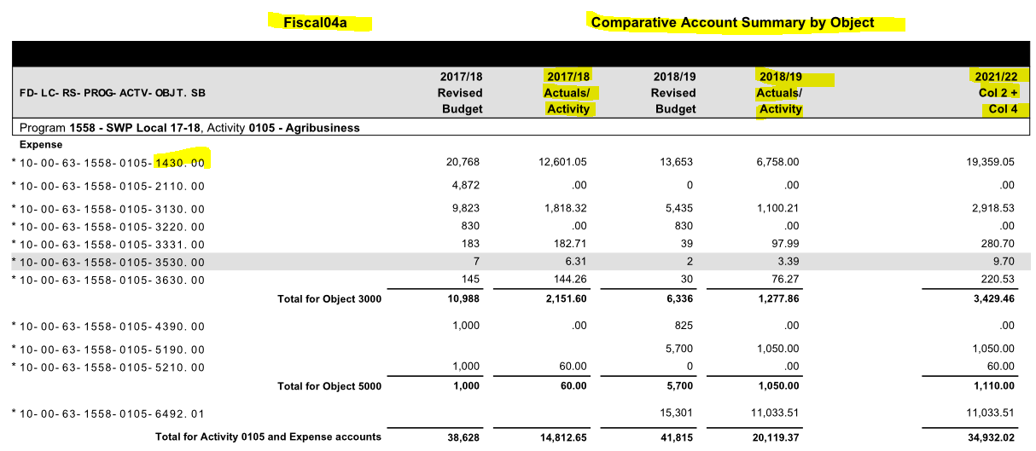
Fiscal 04 Comparative Account Summary by Object

Slide 9
Fiscal 16 Account Component Summary - Balance

Slide 10
Fiscal 06 Comparative Object Summary

Slide 11
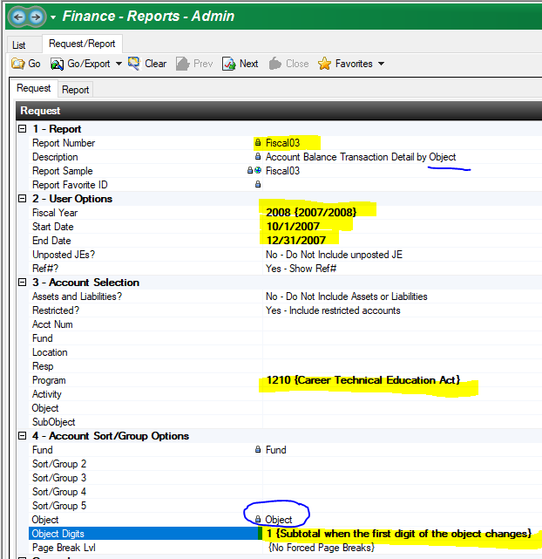
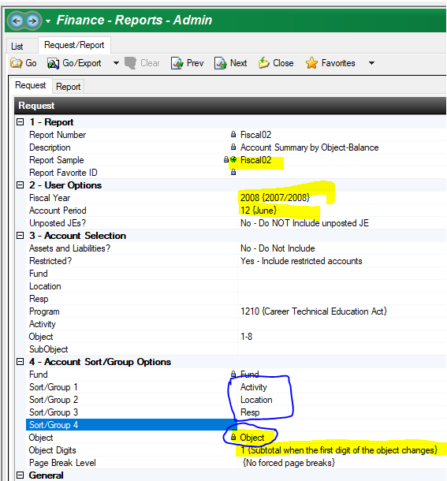
Running or Calling Reports Fiscal 03 - Fiscal 02, Fiscal 16

Slide 12
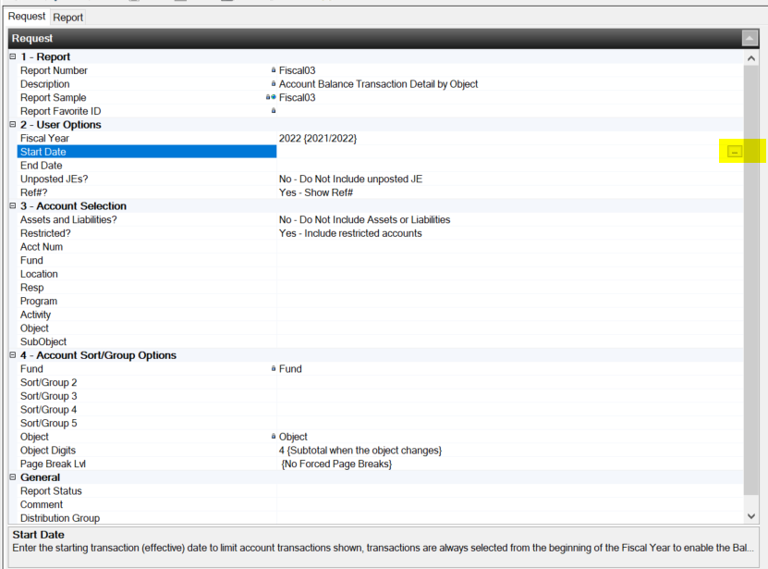
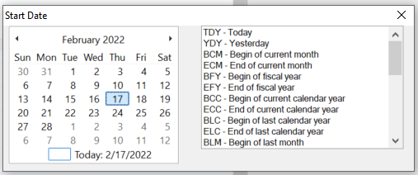
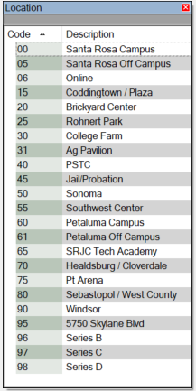
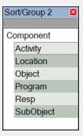
Detailed Look at Calling a Fiscal 03 Report

Slide 13
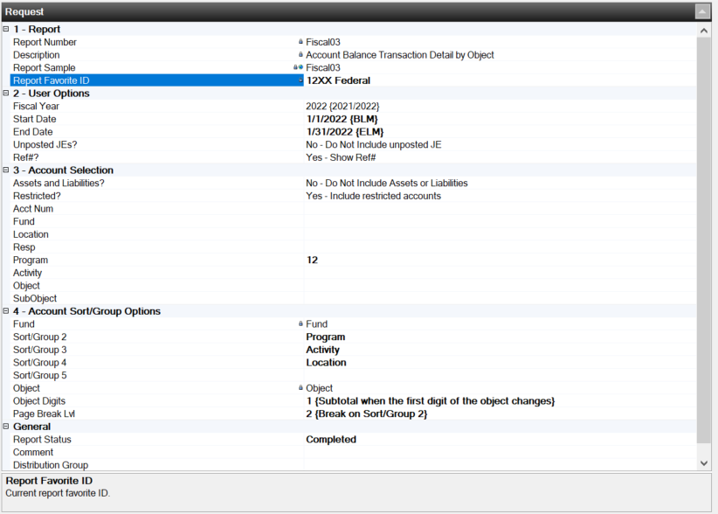
Detailed Look at Calling a Fiscal 03 Report

Slide 14
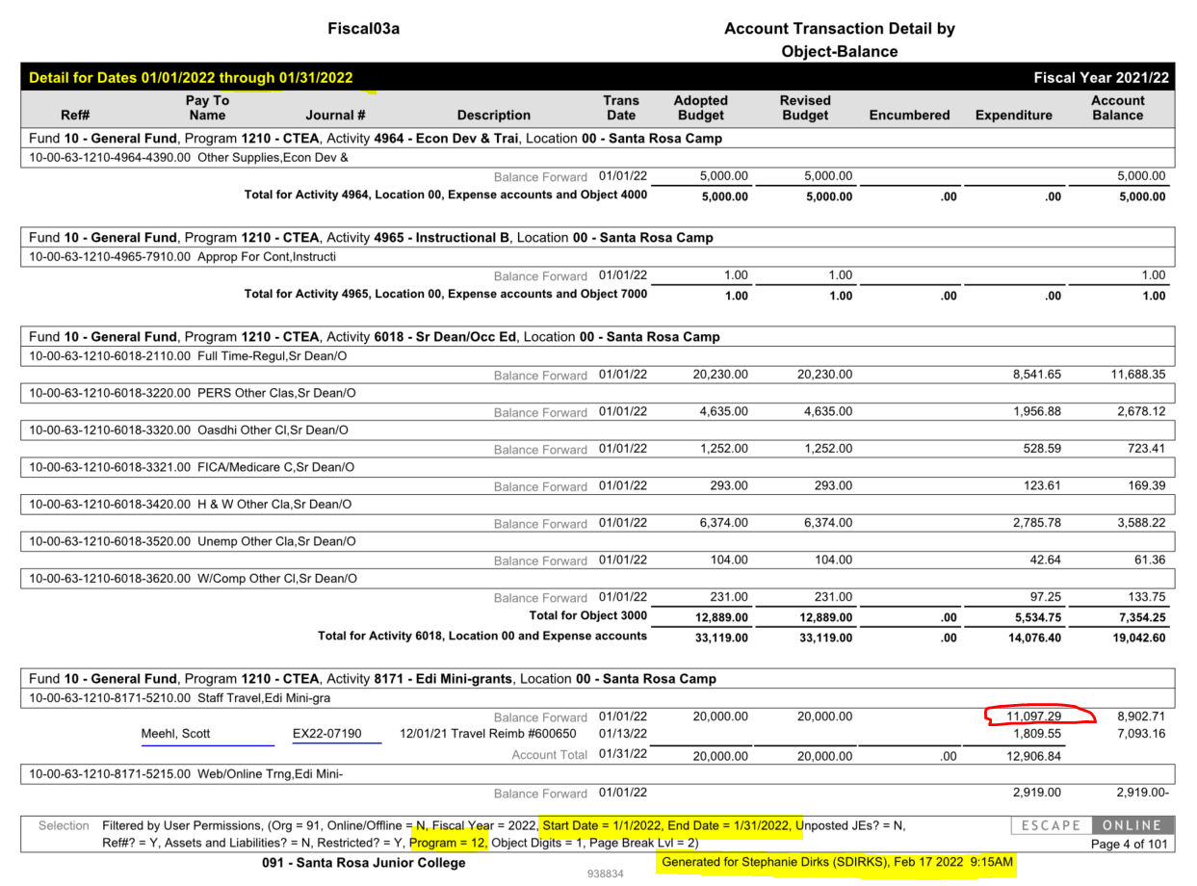
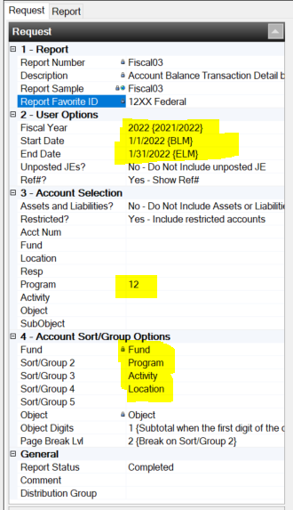

Slide 15
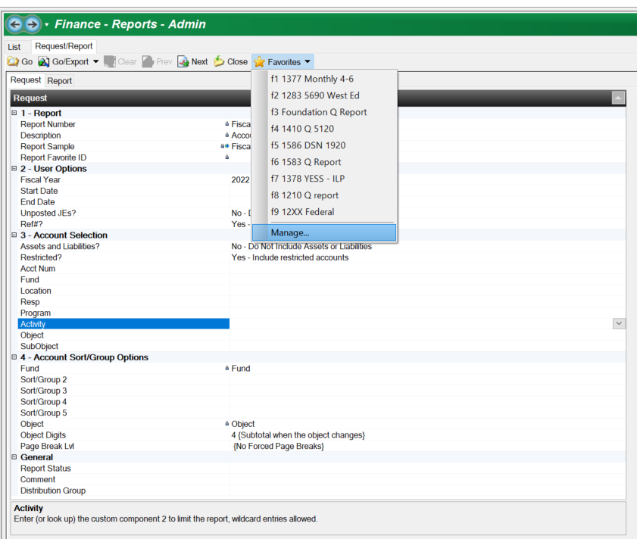
Report Favorites
Select the Star & Select Manage

Slide 16
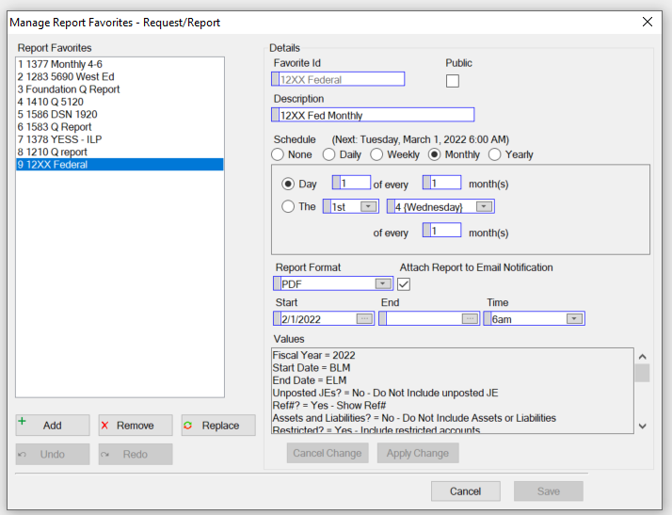
Report Favorites

Slide 17
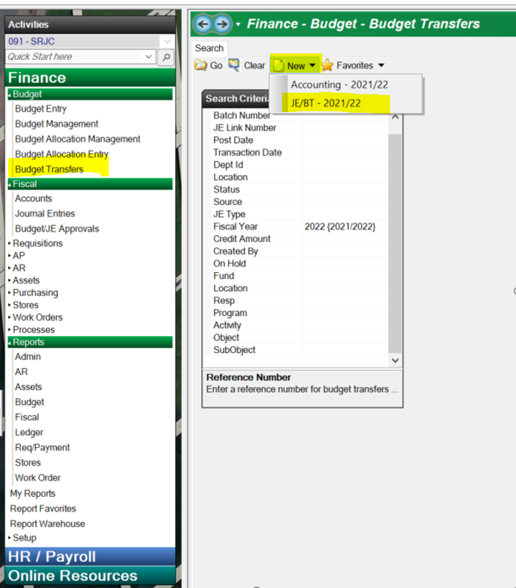
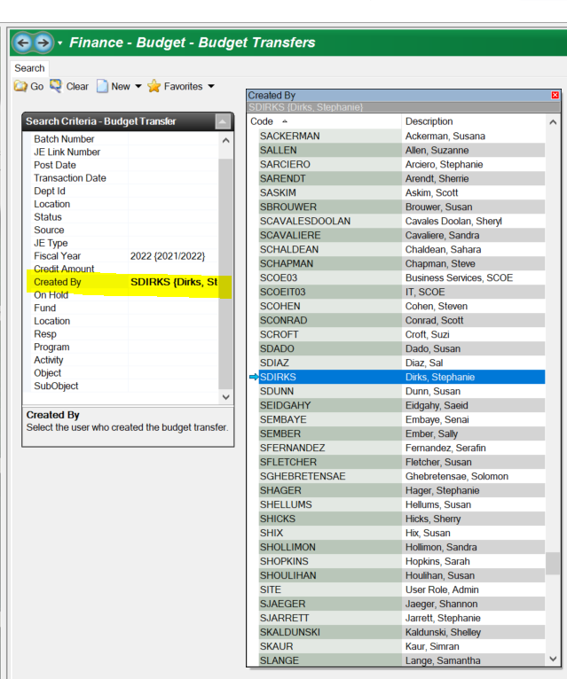
Budget Transfers

Slide 18
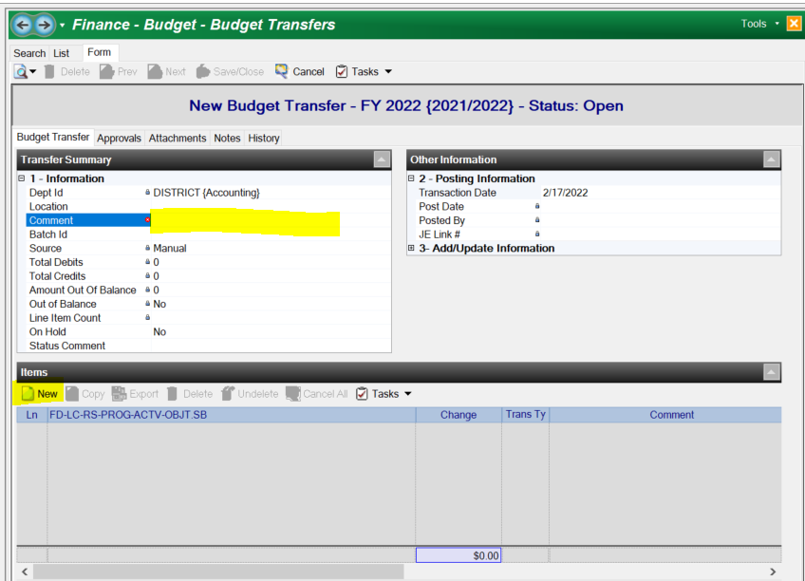
Budget Transfers - Transferring of funds from one object code to another - Transfers need to be within the same program. -Add in a comment that will assist in understanding the Transfer EX: Align Budget EX: Budget for Contract XZY EX: Spring 2022 Budget

Slide 19
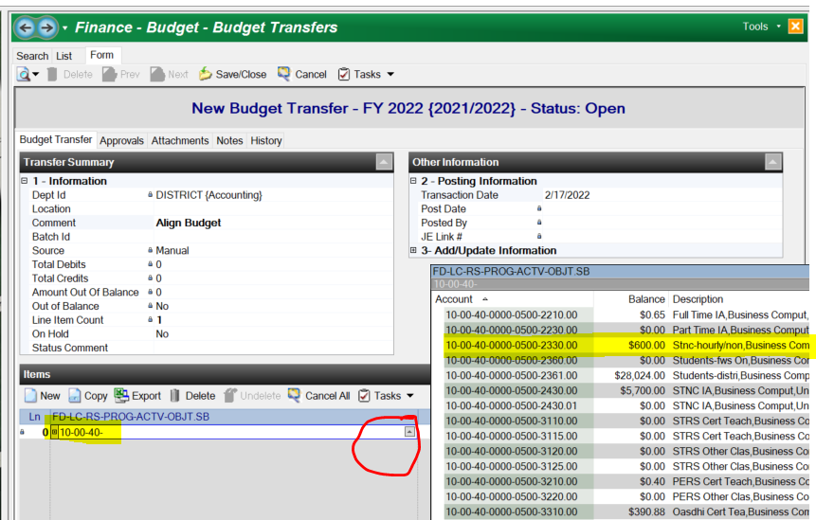
Budget Transfers - type in the budget code, you can enter in a portion and then select the Arrow -You can check the current balance from the Arrow - Budget Transfers must be within the same program

Slide 20
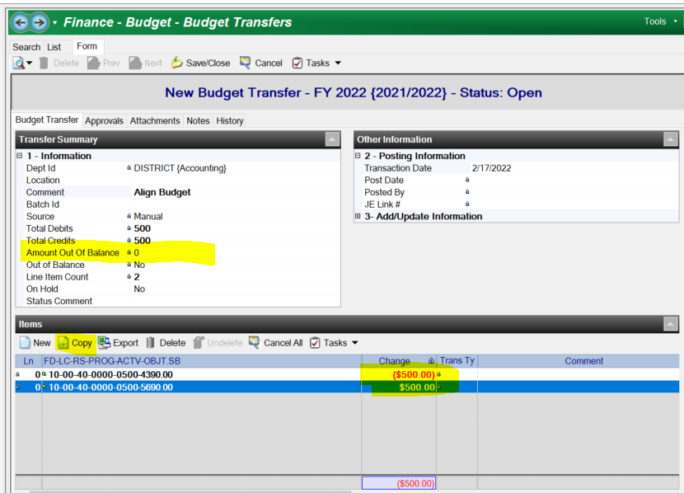
Budget Transfers - Negative for the decrease - Positive for the increase - budget increase must be the same program, in the example, the program is 0000. - Once complete, go up to Tasks and Submit

Slide 21
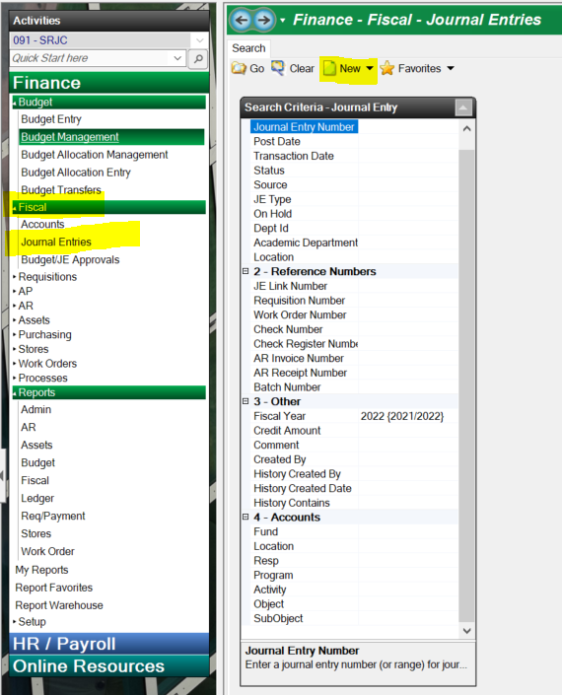
Journal Entries - Moving a posted expenditure from one program to another - ALL Journal entries, must have the same object code

Slide 22
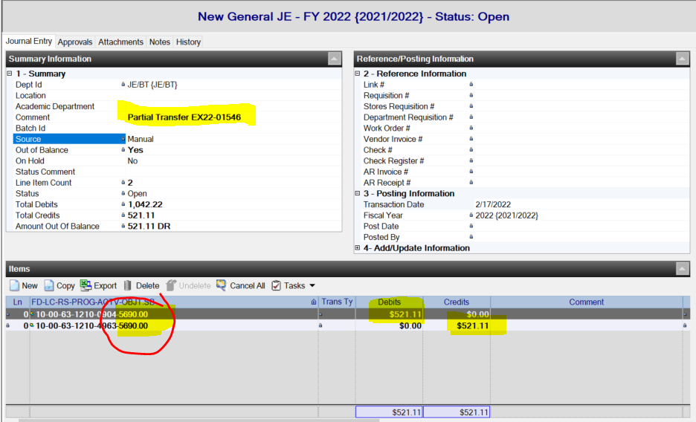
Journal Entries - Moving a posted expenditure from one program to another - Expenditures must be posted…not encumbered - ALL Journal entries, must have the same object code - Debit the Code you would like the expenditure to be charged too -Credit the code that the expenditure is currently charged too

Slide 23
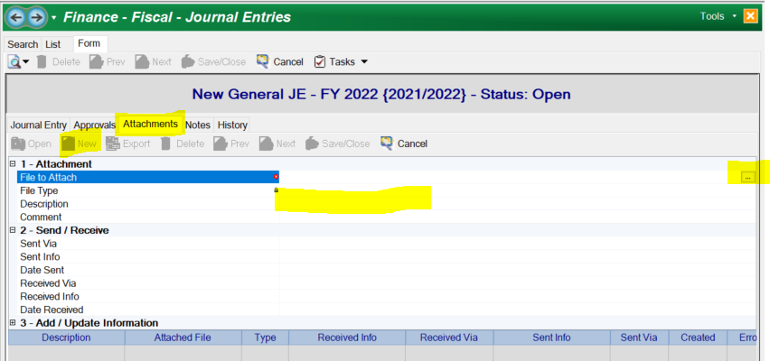
Journal Entries - Add the Fiscal 99 as an attachment in the attachments tab. -Save the Fiscal 99 as a PDF and highlight or note the expenditure you would like to transfer -Add a description “Fiscal 99” or “Ex22-01546” and any other back up attachments you would like to have on file - To submit, go to Tasks icon on top and Submit

Slide 24
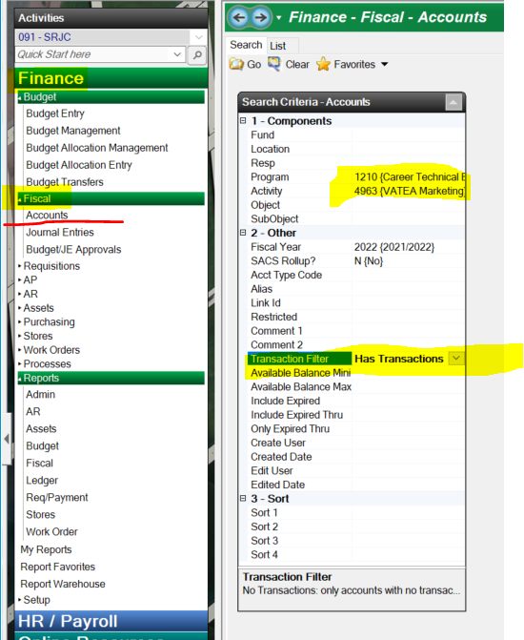
Fiscal 99 - Snapshot - Where do I find the Fiscal 99? -Under Finance, Fiscal, then Accounts - Type in some information in the components tab -Then hit the go button on top -Once you find the account, double click and it will produce the Fiscal 99 in a new window. You can also use a copy of the Fiscal 03 report if you prefer. - Pro Tip – use the “Has transactions” filter to only give you the accounts that have activity

Slide 25
Account Look up (Fiscal 99/Snapshot) - Check to see if you have a code - Remove “Has Transactions” Filter - If the code is not showing, please email the accountant for those programs Stephanie Dirks Sdirks@santarosa.edu for all Categorical/Restricted Programs (If the program code starts with a 1XXX) Shannon O'Reilly soreilly@santarosa.edu if the Program code does not start with a 1XXX Pro tip – Account codes without a budget or expenditures will not show up on a Fiscal repot. please check account look up for linked codes

Slide 26
Q&A
Any Questions?
Please email Stephanie at Sdirks@santarosa.edU if you have any questions.

