Slide 1
Looking Ahead to Spring
Date: December 5th, 2023
Time: 10:00 AM
Presenter: Stephanie Dirks

Slide 2
Housekeeping Items
Thank you for attending
This session is being recorded
Please keep yourself on mute unless you are speaking

Slide 3
Agenda
Fiscal Years and Dates
Timesheet Dates & Fiscal Years
Object Codes for PAFs Overview
Review PAF Date Guidelines FY 2024 & FY 2025
Q & A

Slide 4
Fiscal Years & Dates
SRJC Fiscal Year Runs from 7/1 – 6/30
The Fiscal Year refers to the second year of two years that make up a school year.
Fiscal Year 2024
From July 1st, 2023 – June 30th, 2024
Fiscal Year 2025
From July 1st, 2024 – June 30th, 2025

Slide 5
Timesheet Dates & Fiscal Years
Year End Standard Timesheets
STNCs, Professional Experts and Student Timesheets - Hourly Employees object codes 233X, 2361 & 243X
Timesheet Date: 5/10-6/9 - Paid in the 23/24 Fiscal Year (Standard Timesheet Template)
Timesheet Date: 6/10-7/9 - Paid in the 24/25 Fiscal Year (Standard Timesheet Template)
Associate Faculty Timesheets – Hourly Employees object codes 13XX and 14XX
Timesheet Date: 5/26-6/20 - Paid in the 23/24 Fiscal Year (Standard Timesheet Template)
Timesheet Date: 6/21-7/20 - Paid in the 24/25 Fiscal Year (Standard Timesheet Template)
Year End Liability Timesheets
STNCs, Professional Experts and Student Timesheets - Hourly Employees object codes 233X, 2361 & 243X
Timesheet Date: 5/10-6/9 - Paid in the 23/24 Fiscal Year (Standard Timesheet Template)
Split Timesheet #1 - Date: 6/10-6/30 - Paid in the 23/24 Fiscal Year (Liability Timesheet Template)
Split Timesheet #2 Date: 7/1-7/9 - Paid in the 24/25 Fiscal Year (Standard Timesheet Template)
Associate Faculty Timesheets – Hourly Employees object codes 13XX and 14XX
Timesheet Date: 5/26-6/20 - Paid in the 23/24 Fiscal Year (Standard Timesheet Template)
Split Timesheet Date: 6/21-6/30 - Paid in the 23/24 Fiscal Year (Liability Timesheet Template)
Split Timesheet Date: 7/1-7/20 - Paid in the 24/25 Fiscal Year (Standard Timesheet Template)

Slide 6
Object Codes for PAFs Overview
Object codes important because they define the type of position - Each Employee Classification has a different object code.
Faculty Academic Salaries Component 1000 object codes
Object code 11XX - Instructional Academic Salaries
In order to be instructional, you must answer YES to all three questions below.
Is the person/position in a classroom?
Is the class associated with a section number?
Is the class FTES Generating?
Object code 12XX – Non-Instructional Academic Salaries
Non-instructional academic salaries are generally supporting instruction, but are not in the classroom.
Examples of non-instructional academic salaries are paid to:
Academic Administrators
Counselors
Faculty department chair assignments in load

Slide 7
Object Codes for PAFs Overview
Object code 13XX – Instructional Associate Faculty Hourly Salaries
In order to be instructional, you must answer YES to all three questions below.
Is the person/position in a classroom?
Is the class associated with a section number?
Is the class FTES Generating?
Object code 14XX – Non-Instructional Associate Faculty Academic Salaries
Non-instructional associate faculty academic salaries are for special assignments performed by faculty
Examples of non-instructional academic positions:
Associate Faculty special assignments
Contract Faculty taking overload to complete special assignments

Slide 8
Object Codes for PAFs Overview
Classified Salaries Component 2000 object codes
2100 Classified Salaries
Object code 211X – Full Time Regular Classified Salaries
In order to be full time, the position must be 1.0 FTE (199 days = 9 months, 217 days = 10 months, 238 days = 11months)
Object code 2130 – Part Time Regular Classified Salaries
In order to be part time, the position must be less than 1.0 FTE
If the position is .75 FTE and the person is also working a .25 FTE position, the salary object code would be part time for both positions. The object code is related to the position, not the number of hours worked.
2200 Classified Instructional Aid Salaries
Object code 22XX – Classified Instructional Salaries
In order to be paid by an instructional salary, you must answer YES to all three questions below.
Is the person/position in a classroom?
Is the class associated with a section number?
Is the class FTES Generating?
Object code 2210 – Full Time Classified Instructional Aid Salaries
In order to be full time, the position must be 1.0 FTE (199 days = 9 months, 217 days = 10 months, 238 days = 11months)
Object code 2230 – Part Time Classified Instructional Aid Salaries
In order to be part time, the position must be less than 1.0 FT
If the position is .75 FTE and the person is also working a .25 FTE position, the salary object code would be part time for both positions. The object code is related to the position, not the number of hours worked.

Slide 9
Object Codes for PAFs Overview
233X Non-Instructional Classified Hourly Salaries
Object code 2330 – Non-Instructional STNC Hourly Salaries
Object code 2333 – Non-Instructional Professional Expert Hourly Salaries
Object code 2340 – Non-Instructional Overtime-Classified Hourly Salaries
236X – Student Hourly Salaries (Student employees do not have PAFs, this object code is for timesheets only)
2361 Student Hourly Salaries – District/Work Experience
24XX Instructional Classified Hourly Salaries
Object code 24XX – Instructional STNC Hourly Salaries
In order to be paid by an instructional salary, you must answer YES to all three questions below.
Is the person/position in a classroom?
Is the class associated with a section number?
Is the class FTES Generating?

Slide 10
Why are PAF Dates Important?
Dates are important because they directly relate to how and when an employee is being paid.
Each Employee Classification has a different object code.
Each Set of Object Codes have Different Timesheets and Pay Dates
The Dates on the PAF need to Align with the Dates on the Timesheet
The PAF is the approval for the employee to work the set amount of dates and hours.
For Hourly Employees – If a timesheet is submitted for dates outside of the PAF, a PAF revision will be required.

Slide 11
PAF Date Guidelines FY 2024 & FY 2025
PAF Dates for Faculty Load (budget object codes 11XX and 12XX)
Dates can only be within the Fall or Spring parameters.

Slide 12
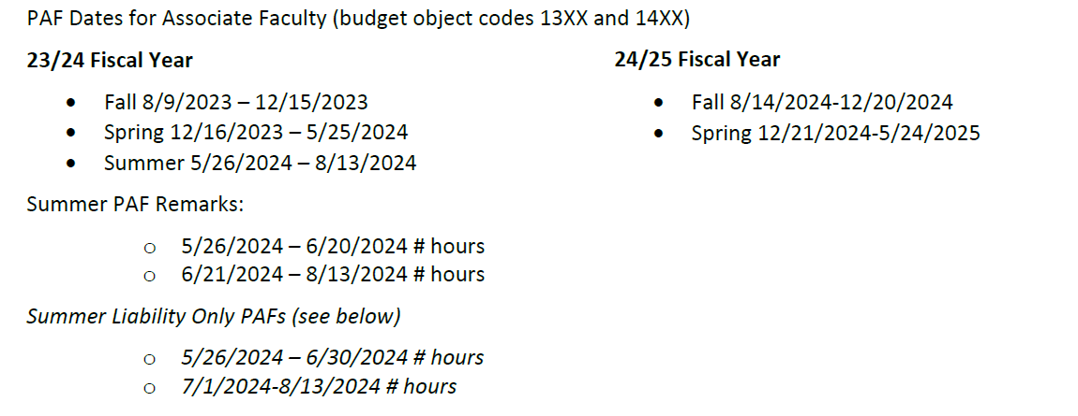
PAF Date Guidelines FY 2024 & FY 2025
PAF Dates for Associate Faculty (budget object codes 13XX and 14XX)
Dates need o follow the semester parameters.
All Summer PAFs can be submitted to cross fiscal years.
Programs that require a Liability Timesheet will need to adjust the comments accordingly, and submit the Liability Timesheets required.

Slide 13
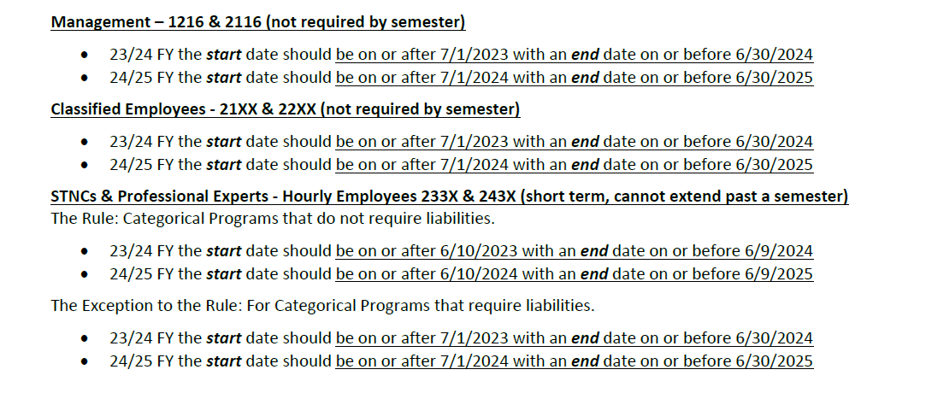
PAF Date Guidelines FY 2024 & FY 2025

Slide 14
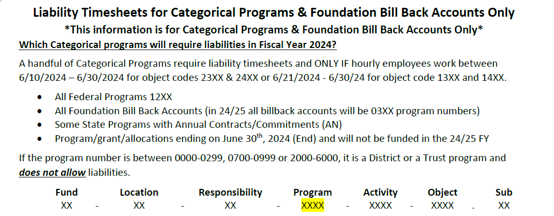
PAF Date Guidelines FY 2024 & FY 2025

Slide 15
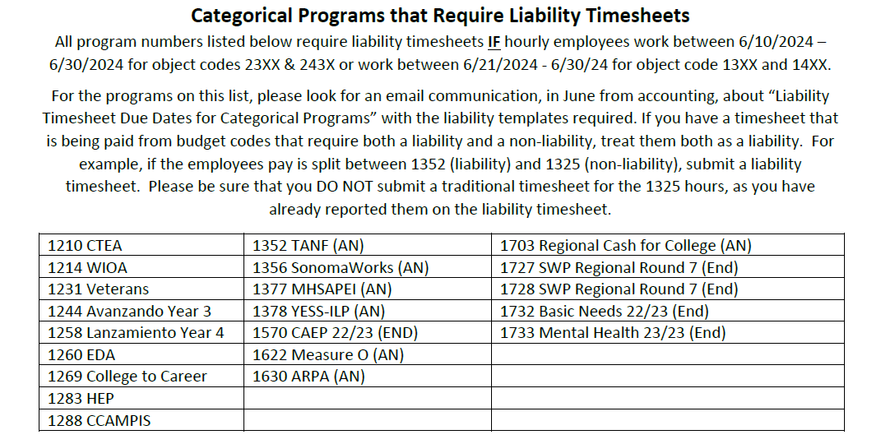
PAF Date Guidelines FY 2024 & FY 2025

Slide 16
PAF Date Guidelines FY 2024 & FY 2025

Slide 17
Timesheet Dates & Fiscal Years
Year End Standard Timesheets
STNCs, Professional Experts and Student Timesheets - Hourly Employees object codes 233X, 2361 & 243X
Timesheet Date: 5/10-6/9 - Paid in the 23/24 Fiscal Year (Standard Timesheet Template)
Timesheet Date: 6/10-7/9 - Paid in the 24/25 Fiscal Year (Standard Timesheet Template)
Associate Faculty Timesheets – Hourly Employees object codes 13XX and 14XX
Timesheet Date: 5/26-6/20 - Paid in the 23/24 Fiscal Year (Standard Timesheet Template)
Timesheet Date: 6/21-7/20 - Paid in the 24/25 Fiscal Year (Standard Timesheet Template)
Year End Liability Timesheets
STNCs, Professional Experts and Student Timesheets - Hourly Employees object codes 233X, 2361 & 243X
Timesheet Date: 5/10-6/9 - Paid in the 23/24 Fiscal Year (Standard Timesheet Template)
Split Timesheet #1 - Date: 6/10-6/30 - Paid in the 23/24 Fiscal Year (Liability Timesheet Template)
Split Timesheet #2 Date: 7/1-7/9 - Paid in the 24/25 Fiscal Year (Standard Timesheet Template)
Associate Faculty Timesheets – Hourly Employees object codes 13XX and 14XX
Timesheet Date: 5/26-6/20 - Paid in the 23/24 Fiscal Year (Standard Timesheet Template)
Split Timesheet Date: 6/21-6/30 - Paid in the 23/24 Fiscal Year (Liability Timesheet Template)
Split Timesheet Date: 7/1-7/20 - Paid in the 24/25 Fiscal Year (Standard Timesheet Template)

Slide 18
Q&A
Any Questions?

