Slide 1
Why Activity Codes and Object Codes Are Important and How to Choose
Date: November 14th, 2023
Time: 10:00 AM – 11:00 AM
Presenter: Stephanie Dirks

Slide 2
Housekeeping Items
Thank you for attending
This session is being recorded
Please kept yourself on mute unless you are speaking

Slide 3
Agenda
Overview of 311 Report & the 50% Law
A Detailed Budget Code Story
Activity Codes
Object Codes/Live Escape Demonstration
Q & A

Slide 4
311 Report and 50% Law
311 Report
This is our state wide alignment fiscal report.
Used to report revenues and expenditures for the previous fiscal year and the budget for the next fiscal year.
The state uses this report to compare spending across categories.
50% Law
50% law – 50% of our unrestricted general fund expenses must be spent in the classroom. This is our classroom faculty and classified support salary and benefits and any instructional service agreements.
FON (Faculty Obligation Number) – Number of full-time credit faculty that we must have in the District.

Slide 5
A Budget Story - Overview
Every component tells a part of the story
Fund – almost all are Fund 10 – General Fund
Location – physical location of where the funds are being spent
Responsibility – Who oversees the funds - Dean, VP
Programs that start with a 1XXX are Categorical
Programs that begin with any other number are District
Activity Codes – state mandated, gives more information about the use of the funds
Object Code – defines the type of expenditure
4390 – supplies, 1430 – associate allied, 5210 – staff travel

Slide 6
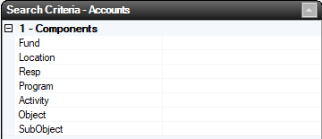
A Budget Code Story - Detail

Slide 7
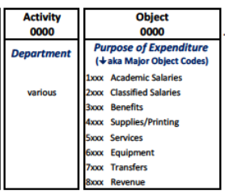
Activity Code Guidelines
General Guidelines
Activity Codes 01XX-49XX are instructional
Activity Codes 6XXX are support services
Instructional Codes
Activity Codes 6XXX cannot have any 11XX, 13XX or 22XX & 24XX object codes, as those are for instructional use ONLY
Exceptions – 611X activity codes are for “Learning Centers” – these can have 11XX, 13XX and 22XX, 24XX object codes
Direct to Student Aid/Expenditures (76XX object codes)
Activity Codes 01XX-59XX cannot have any 7XXX object codes
Not All 6XXX can have 7XXX object Codes
Activity Codes that CAN have 7XXXs Student Funds are - 6410,6420, 6430, 6490

Slide 8
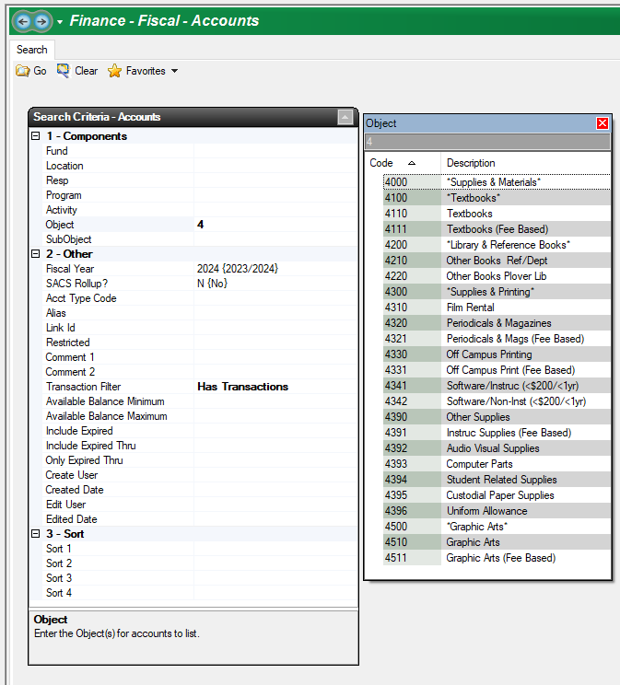
Object Codes
How to search in Escape.
Let’s go live in Escape!

Slide 9
Equipment from Supply Items

Slide 10
Q&A
Any Questions?

