Slide 1
NOVA Reporting & What Fiscal Reports are Best
Date: October 10th, 2023
Time: 10:00 AM – 11:00 AM
Presenter:
Stephanie Dirks

Slide 2
Housekeeping Items
Thank you for attending
This session is being recorded
Please kept yourself on mute unless you are speaking

Slide 3
Agenda
Overview of NOVA – CCCCO Reporting Platform
A Budget Code Story
Types of Reports
Fiscal 04 & Fiscal 06 – Multi-Year Reports
Q & A

Slide 4
A Budget Story
Every component tells a part of the story
Fund – almost all are Fund 10 – General Fund
Location – physical location of where the funds are being spent
Responsibility – Who oversees the funds - Dean, VP
Programs that start with a 1XXX are Categorical
Programs that begin with any other number are District
Activity Codes – state mandated, gives more information about the use of the funds
Object Code – defines the type of expenditure
4390 – supplies, 1430 – associate allied, 5210 – staff travel

Slide 5
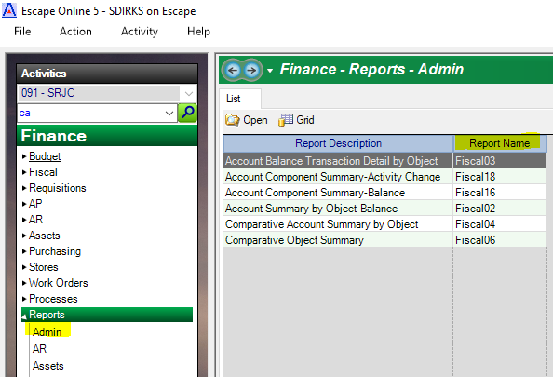
Fiscal Reports
Fiscal 03
Account Balance Transaction Detail by Object
Fiscal 02
Component Summary – Balance
Fiscal 04
Comparative Account Summary by Object
Fiscal 16
Account Component Summary - Balance
Fiscal 06
Comparative Object Summary

Slide 6
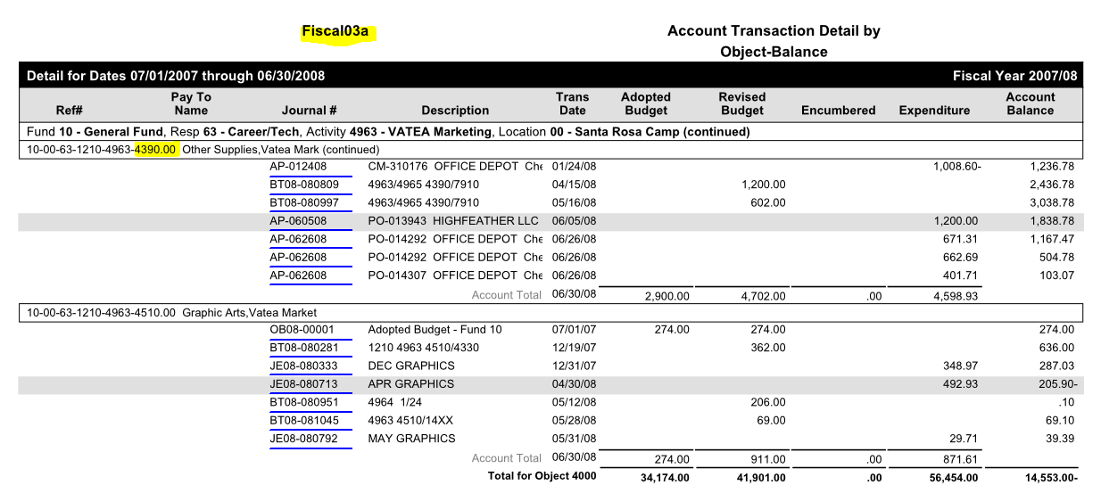
Fiscal 03 Account Transaction Detail by Object - Balance

Slide 7
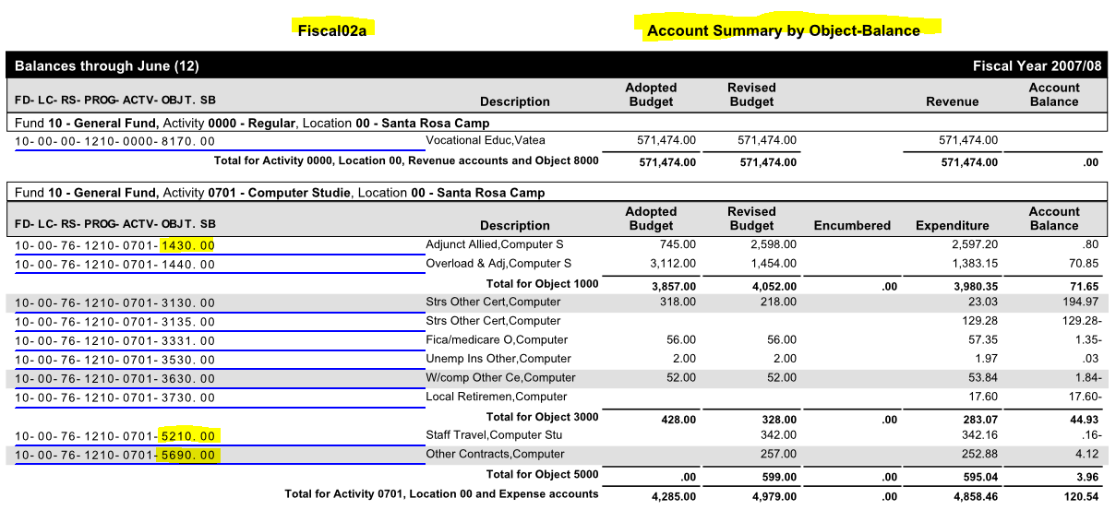
Fiscal 02 Component Summary – Balance

Slide 8
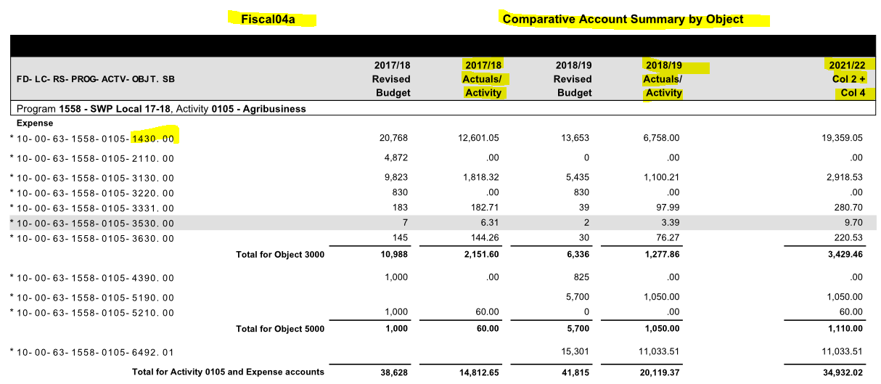
Fiscal 04 Comparative Account Summary by Object

Slide 9
Fiscal 16 Account Component Summary - Balance

Slide 10
Fiscal 06 Comparative Object Summary

Slide 11
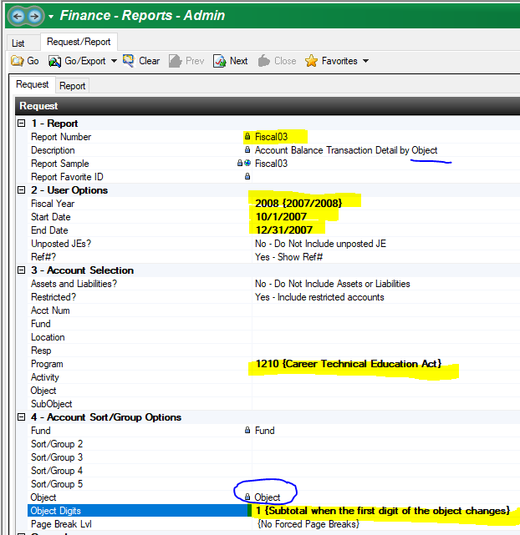
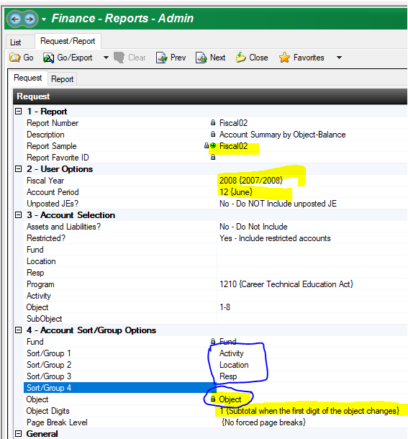
Running or Calling Reports Fiscal 03 - Fiscal 02, Fiscal 16

Slide 12
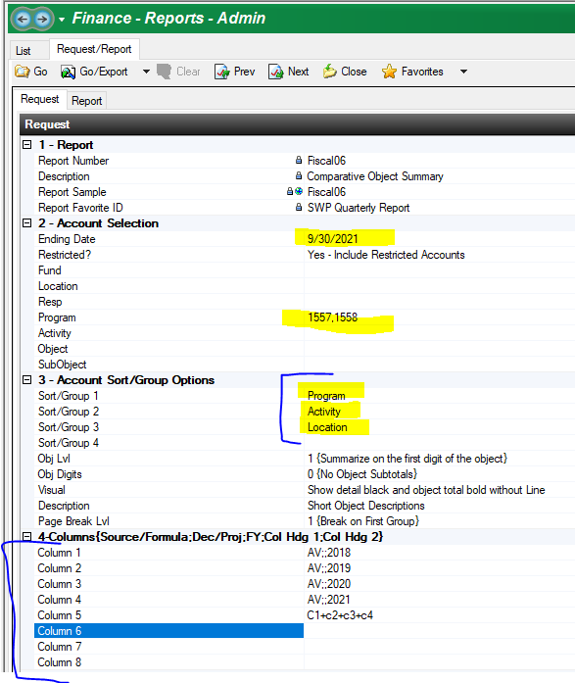
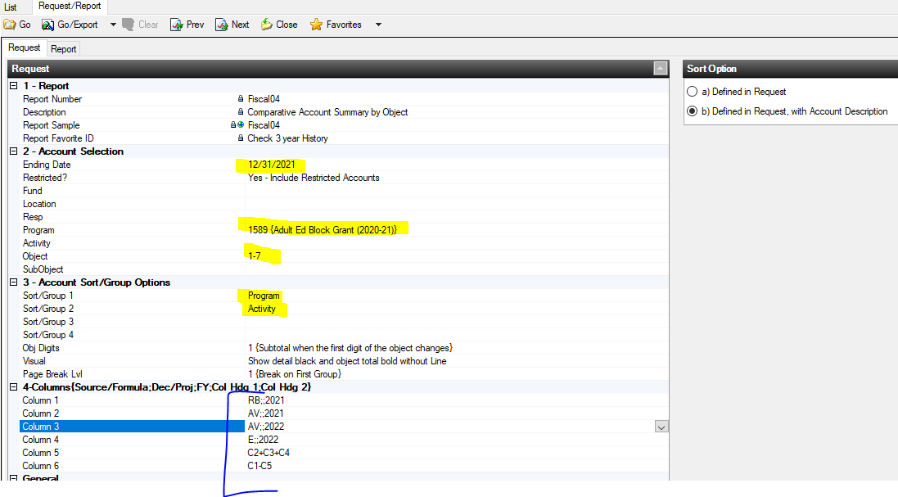
Running or Calling Reports Fiscal 04 & Fiscal 06

Slide 13
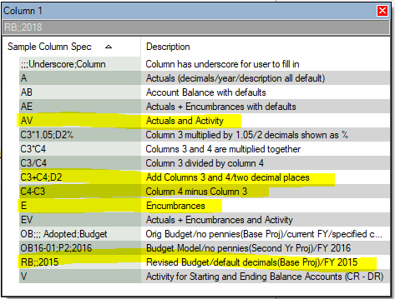
Fiscal 04 & Fiscal 06 Column Specs
RB;;2021 – Revised budget for Fiscal year 2021
AV;;2021 – Actual Expenditures in Fiscal year 2021
AV;;2022 – Actual Expenditures in Fiscal year 2022
E;;2022 – Actual Expenditures to date in Fiscal year 2022 (you could use AE for both Actuals and Encumbrances – AE;;2022)
C2+C3+C4 – Column 2 + Column 3 + Column 4 (Actual Expenditures in Fiscal year 2021 + Actual Expenditures in Fiscal year 2022 + Encumbrances in Fiscal year 2022 as of the ending date on the report
C1-C5 - Column 1 - Column 5 (2021 Revised Budget – the sum of (2021 Actuals +2022 Actuals + 2022 Encumbrances) which will equal the balance based on the whole budget amount established in 2020.

Slide 14
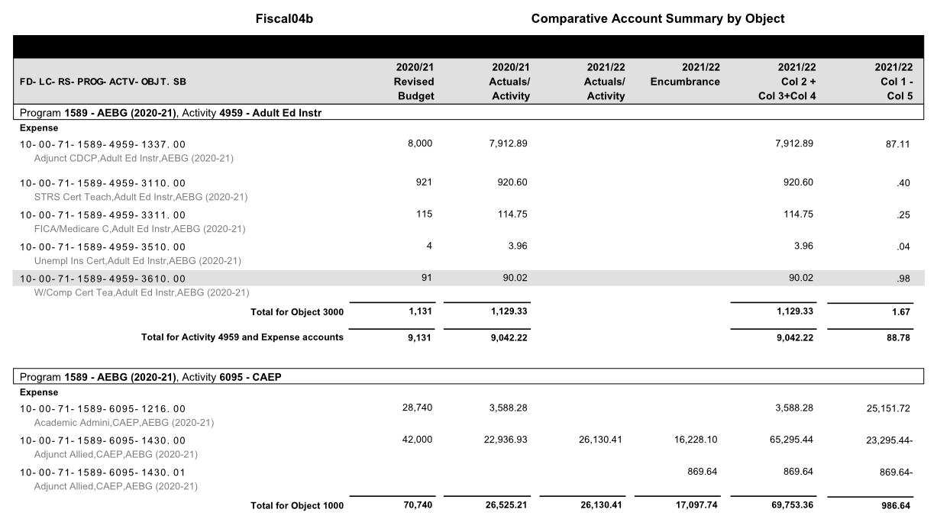
Fiscal 04 – Example Report

Slide 15
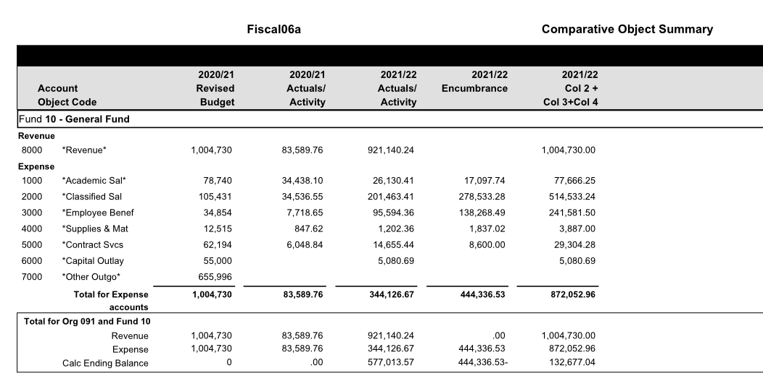
Fiscal 06 – Example Report

Slide 16
Q&A
Any Questions?

