Slide 1
Tuesday Trainings Adopted Budget
Date: September 18th 2023
Time: 1:00 PM
Presenter: Stephanie Dirks

Slide 2
Housekeeping Items
Thank you for attending
This session is being recorded
Please kept yourself on mute unless you are speaking

Slide 3
Agenda
Overview of Escape
A Budget Code Story
Review Your Adopted Budget
Check the health of your Budget
Two Ways – Fiscal Report, or Account Look Up
Encumbered Funds
Requests to Disencumber Funds
Budget Transfers VS Expenditure Transfers
Q & a

Slide 4
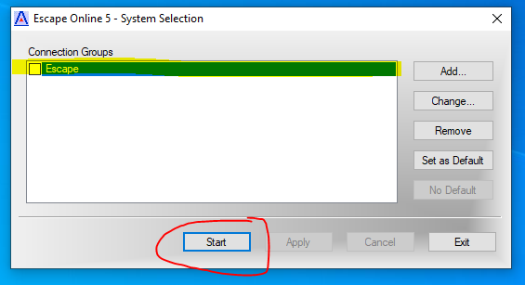
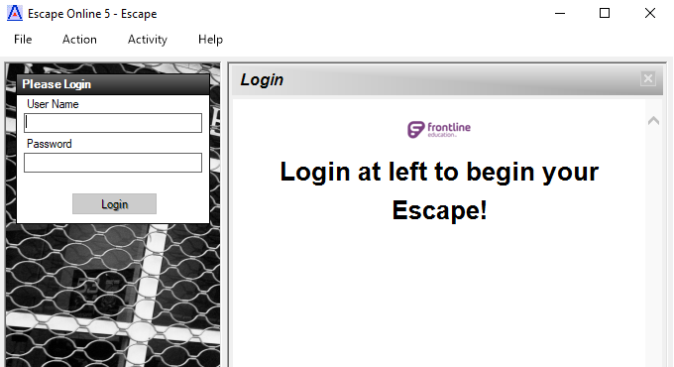
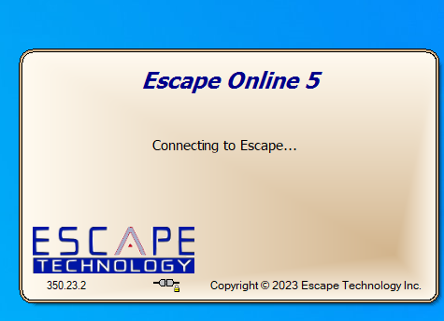
Overview of Escape
The App is called “Run Online5.exe”
Open the app and highlight Escape, then select “Start”
Once the program loads, log in using your User Name and Password
Forgot your password? E-mail Shannon at soreilly@santarosa.edu

Slide 5
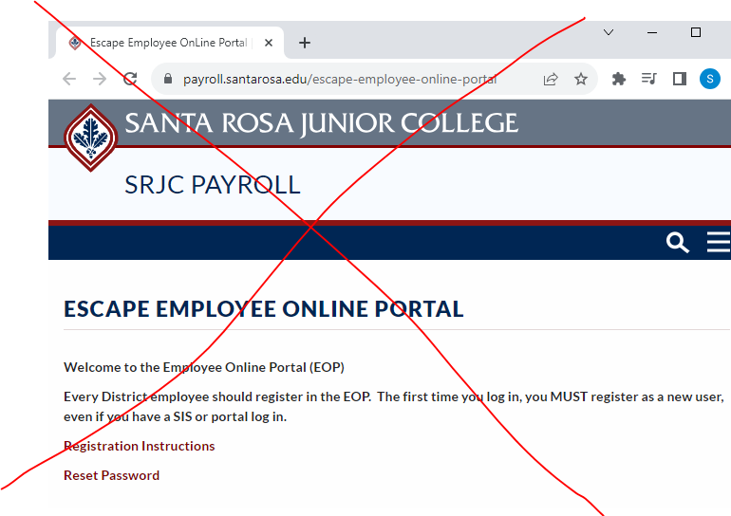
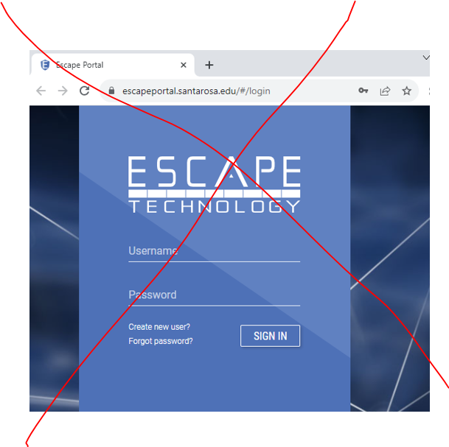
Escape Employee Online Portal For HR, Not for Accounting

Slide 6
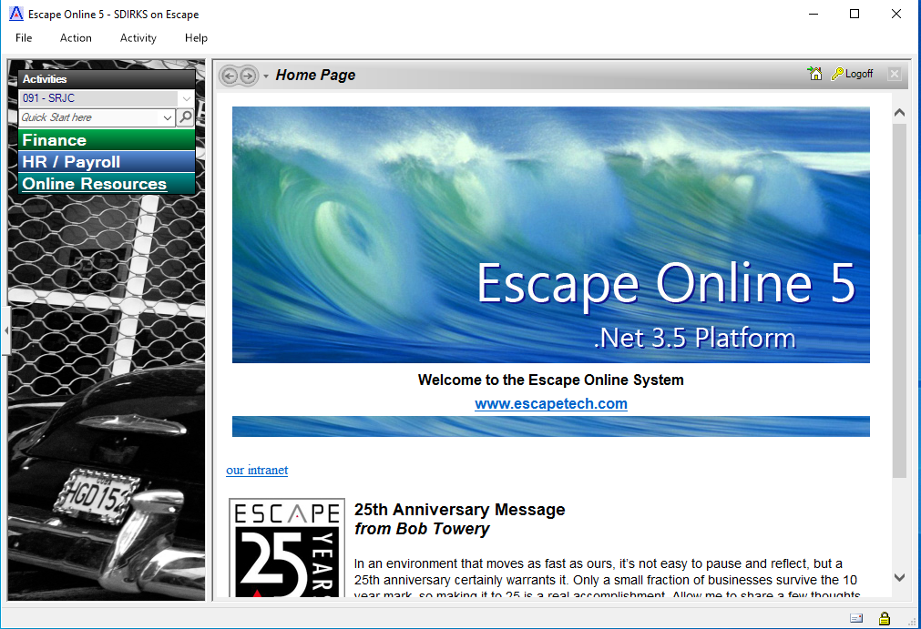
Overview of Escape
Title Bar
The Activity Pane displays the Organization drop down and the Activities
The Activity Tree only displays activities for which you have permissions
The Workspace is the largest, the space all of your work will take place
Workspace
Activity Pane with Org and Activity Tree

Slide 7
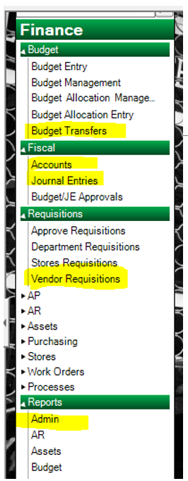
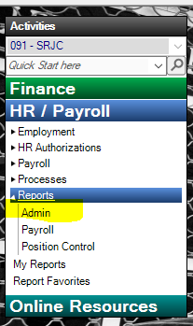
Activity Tree
Budget
Budget Transfers
New
Fiscal
Accounts (Account Look Up)
Journal Entries
New
Requisitions
Vendor Requisitions
New
Reports
Admin
Fiscal 02
Fiscal 03
Fiscal 04
Fiscal 06
Reports
Admin
Pay 09
Pay 10

Slide 8
A Budget Story
Every component tells a part of the story
Fund – almost all are Fund 10 – General Fund
Location – physical location of where the funds are being spent/work is being done
Responsibility – Who oversees the funds - Dean, VP
Programs that start with a 1XXX are Categorical
Programs that begin with any other number are Unrestricted
Activity Codes – state mandated, gives more information about the use of the funds
Object Code – defines the type of expenditure
4390 – supplies, 1430 – associate allied, 5210 – staff travel

Slide 9
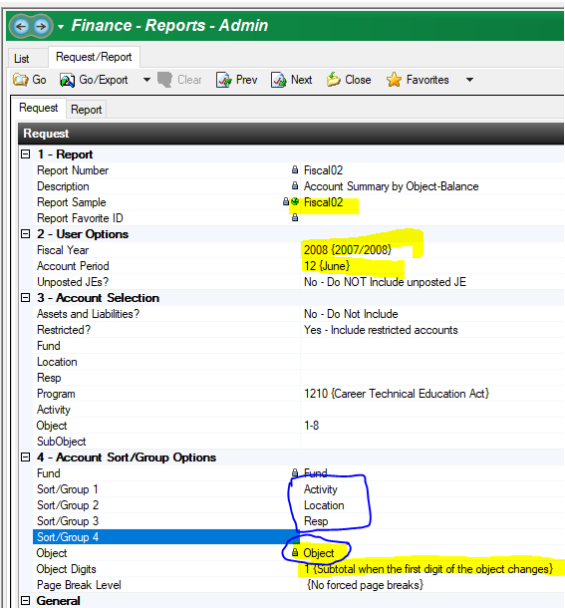
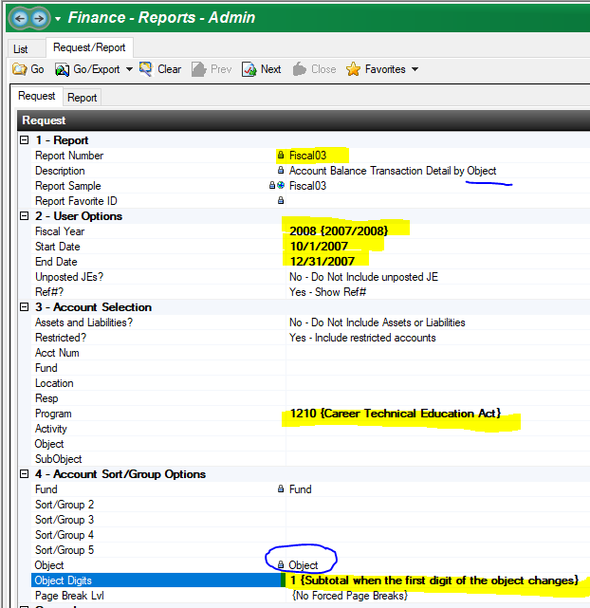
Running or Calling Reports Fiscal 02 & Fiscal 03

Slide 10
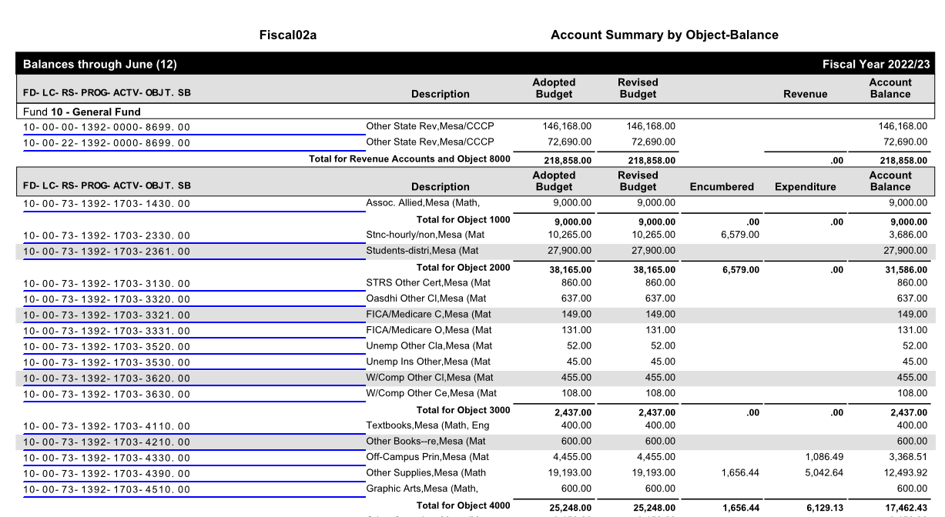
Fiscal 02 Component Summary – Balance
1000-7000s are expenditure codes
8000s are Revenue

Slide 11
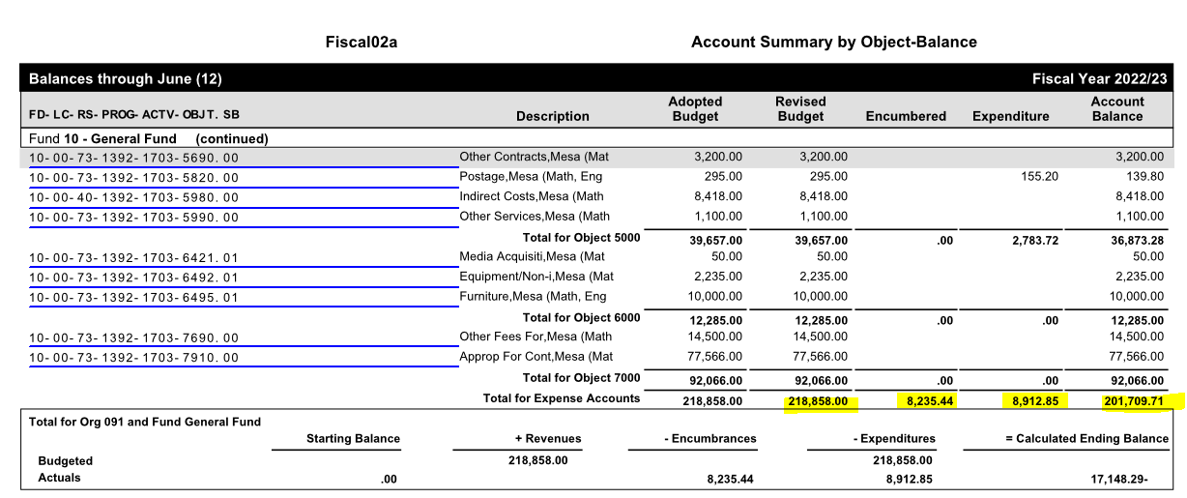
Fiscal 02 Component Summary – Balance
The Adopted Budget will always remain the same
The Revised Budget is your budget that is reflecting any budget transfers submitted
The Account balance is the Revised Budget, minus Encumbered, minus Expensed

Slide 12
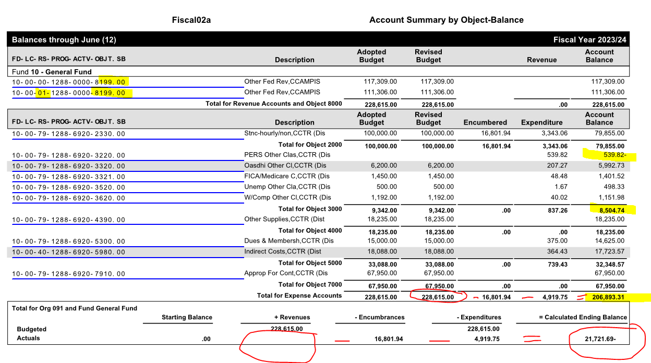
Healthy Budget
Carryover is listed as an 8000s with the resp 01
In the Account Balance, look for negative items
The component needs to be positive overall

Slide 13
Encumbered Funds
Contract/faculty (11XX, 12XX, 21XX, 22XX) have “Salary Encumbrance”
Hourly staff have PAFs, PAFs are manually encumbered and should automatically disencumber when funds are expended
Student Employees (236X) are not encumbered.

Slide 14
Request to Disencumber Funds
Review all of your Summer PAFs and email me to disencumber any PAFs that were not fully expended.
To do so, please email me the following information:
PAF Number and Name (if not a Master PAF)
The Budget Code for the PAF
The unused amount to be disencumbered
EX: Kaasch PAF 23-5217
10-00-80-1593-6480-2330.00
$1,320.00

Slide 15
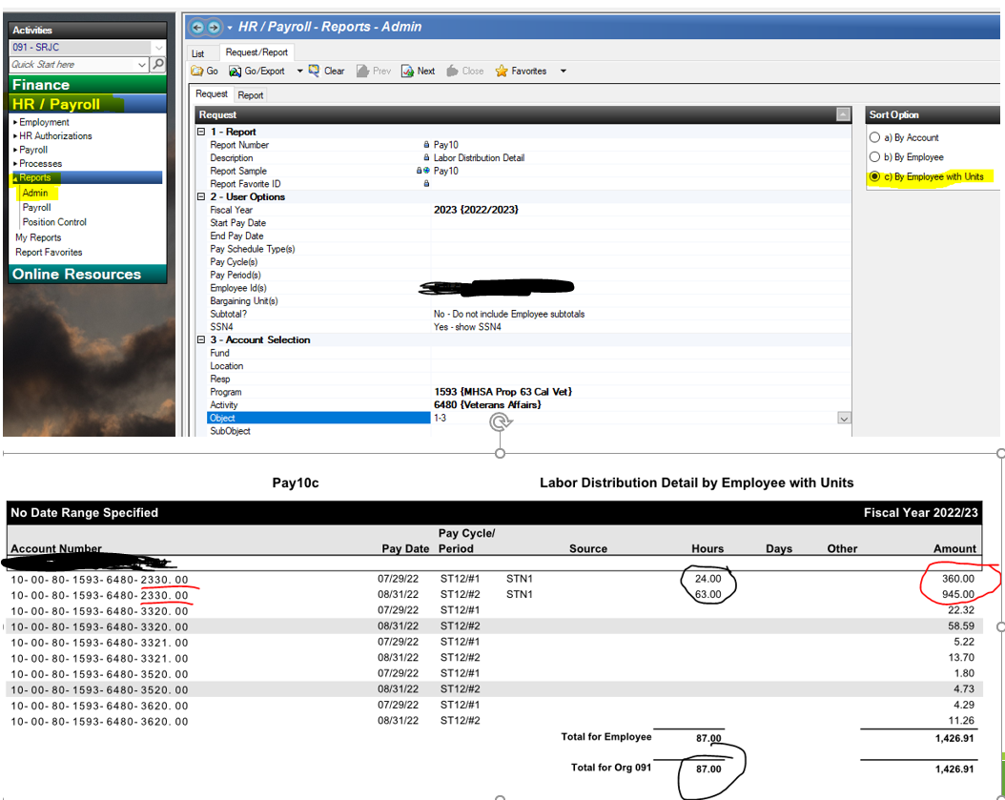
Pay 10C
To compare how many hours have been expended, pull a Pay 10C report.
Search by employee number, and/or by the program.
Compare the number of hours paid to the number of hours submitted.
If all the hours have been PAID, email me to disencumber the remaining funds.

Slide 16
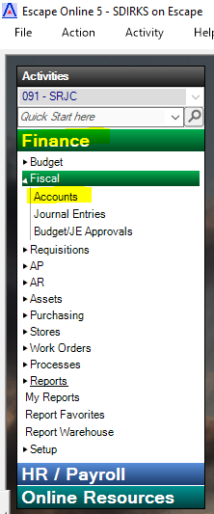
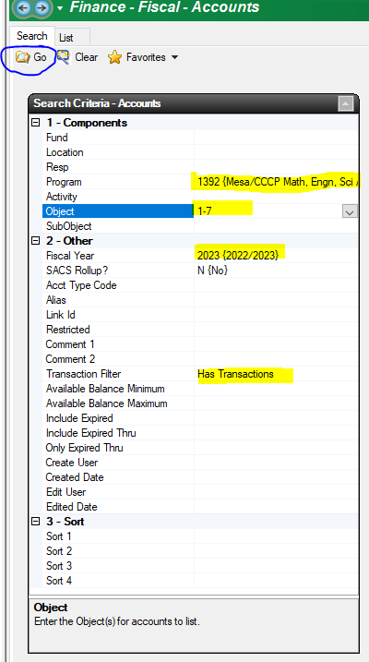
Adopted Budget Account Look Up
Under Finance, Select “Accounts”
In the Search Criteria, add in a component to search and a Fiscal Year
Then Select “Go” in the upper left hand corner
Pro-Tip: Use the “Has Transactions” Filter & Add in Object 1-7

Slide 17
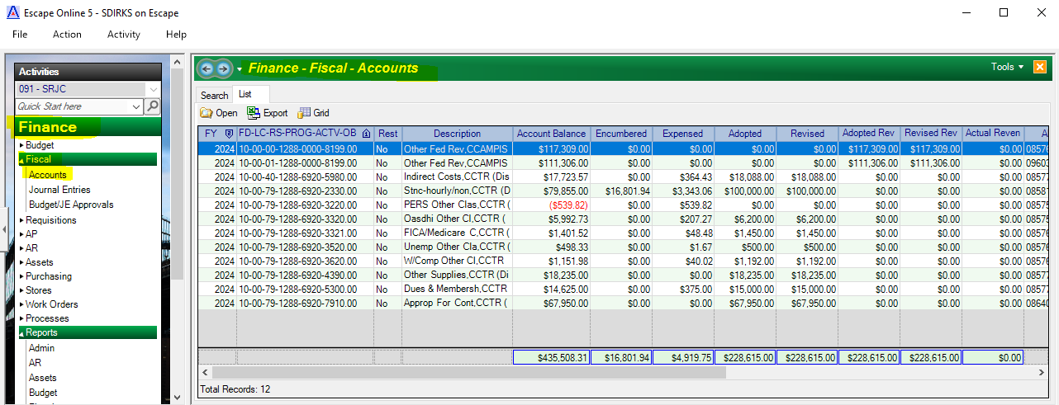
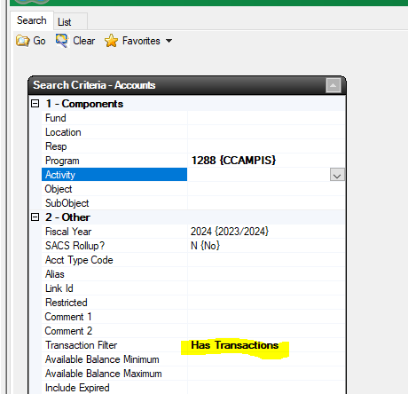
Accounts – “Account Look Up”
Limited to 1-7 Object codes
The Account balance is the Revised Budget, minus Encumbered, minus Expensed.
In the Account Balance, look for items in red.
The component needs to be positive overall

Slide 18
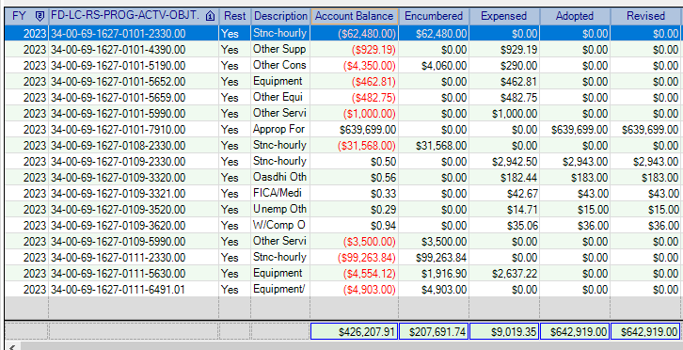
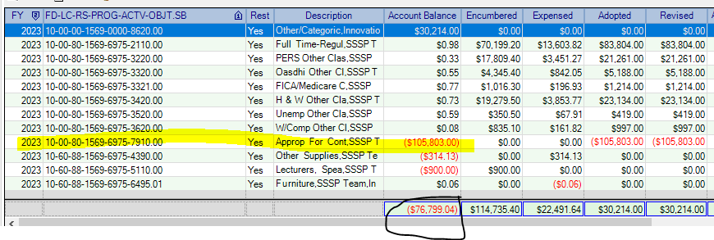
Unhealthy Budget
Example 1: Overall Account Balance is positive - Budget Transfers Required
Example 2: Overall Account Balance is negative
To balance the budget, a credit was placed in the 7910 account.
Once the PAF for 2110 is corrected, those funds will need to be transferred to 7910 to clear the negative.

Slide 19
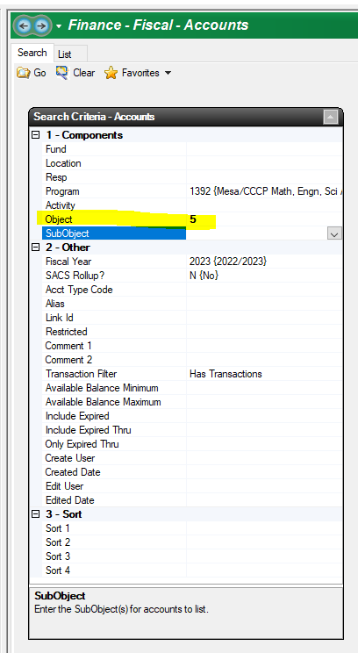
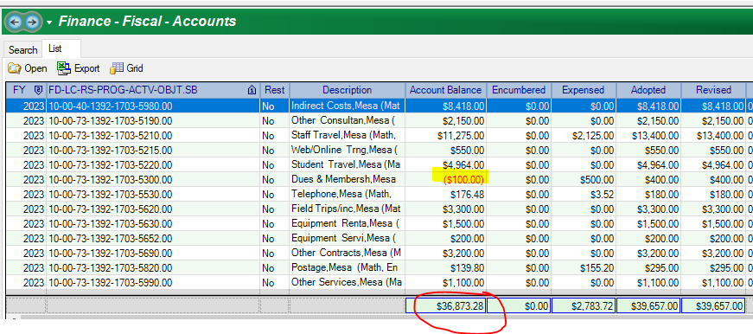
Drill Down in Account Look Up
Drill down to the components
The whole component just needs to be in the positive
EX: 5300 is in the red, but overall the 5000s component has $36,873.28.
A budget transfer is not required, as long as the component is positive.

Slide 20
Budget Management Tool
This is an optional workbook, to assist departments with your projections and overall budget management.
Only the Blue Highlighted Areas in the workbook are unlocked, so those are the only fields you need to enter information into, once you have copied in the Escape Grid

Slide 21
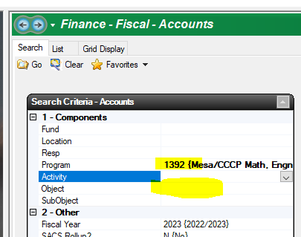
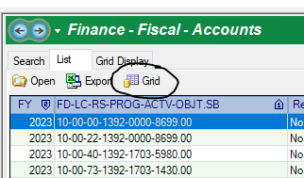
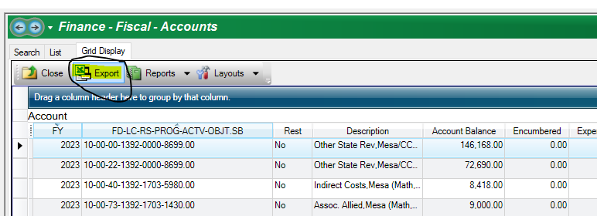
Budget Management Tool
Account Look Up
Leave object blank
Select “Go”
Once it is Displayed, select “Grid”
Then Select “Export”
An Excel temp file will populate
Select B2 through the end of the data, then copy
Open the workbook, select A14 and paste

Slide 22
Budget Management Tool
Almost there!

Slide 23
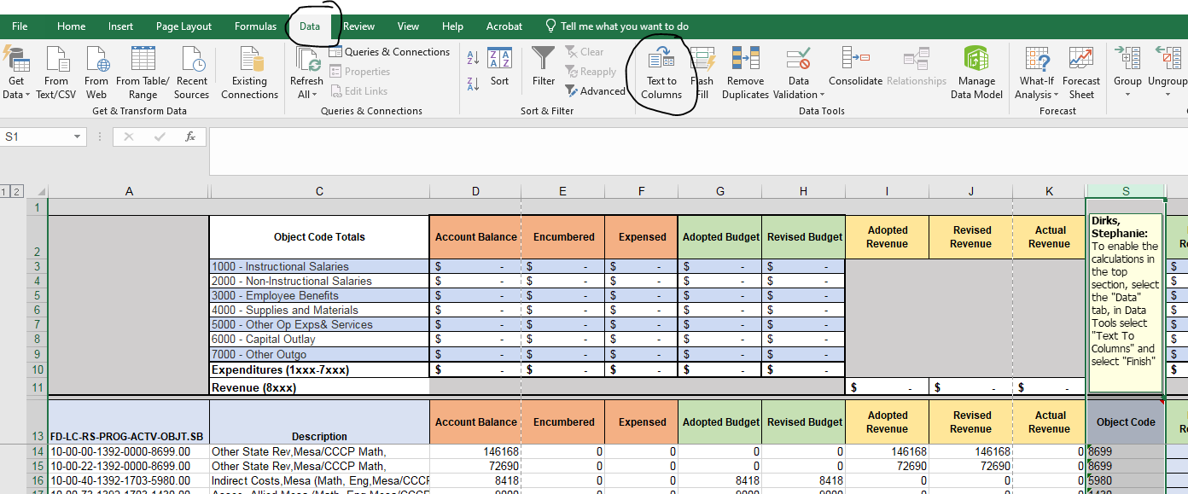
Budget Management Tool
To enable calculations, select column S, then in the “Data” tab, select “Text to Columns” then “Finish”

Slide 24
Budget Management Tool
Now your workbook is ready for your projections and budget transfer tracking
In the highlighted blue columns, you can enter in your projections.

Slide 25
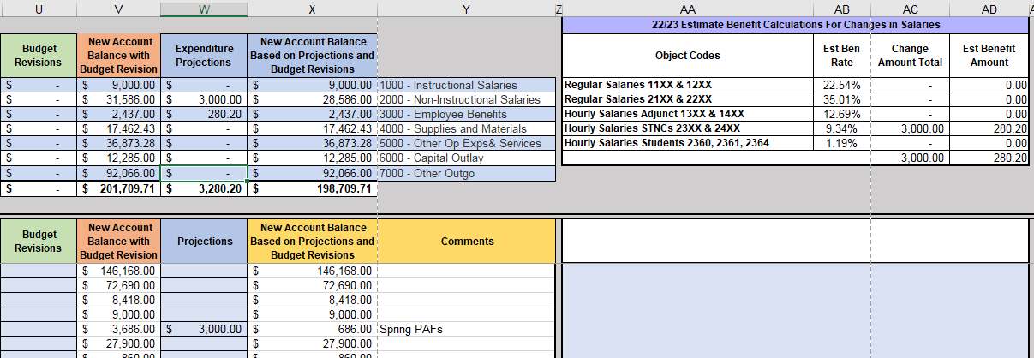
Budget Management Tool
EX: Add $3000 PAF to 2330, the Benefit Calculator will estimate, you will need an additional $280.20 to cover the benefits.
Looking at your overall budget, you can see your original balance was $201K, with the new PAF, you have a new remaining balance of $198K, so this projection is within budget.

Slide 26
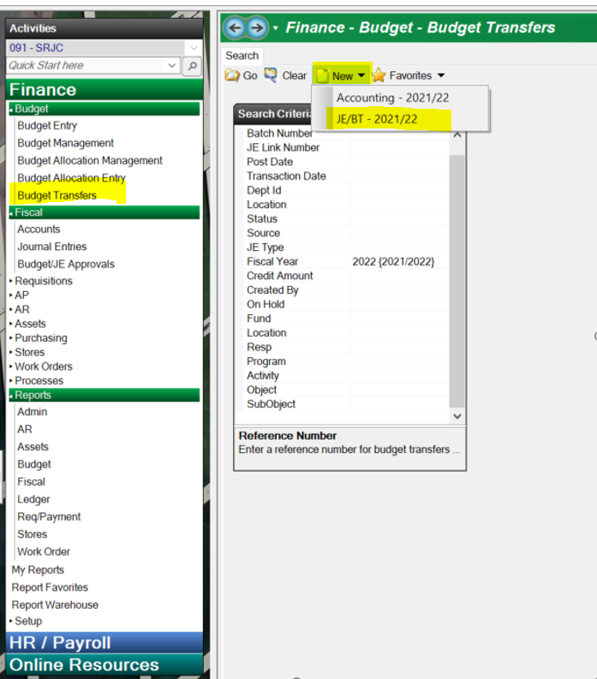
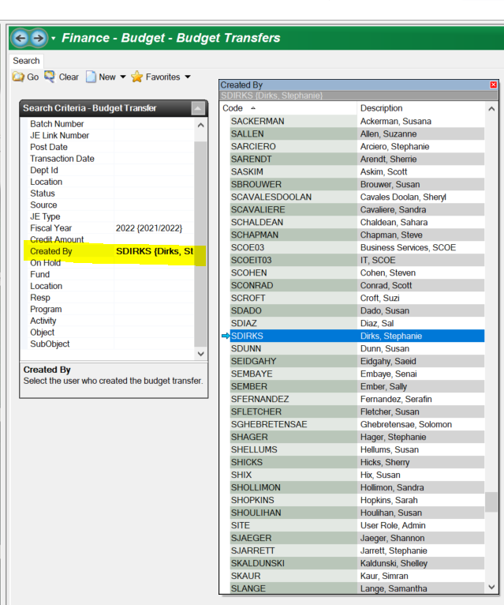
Budget Transfers

Slide 27
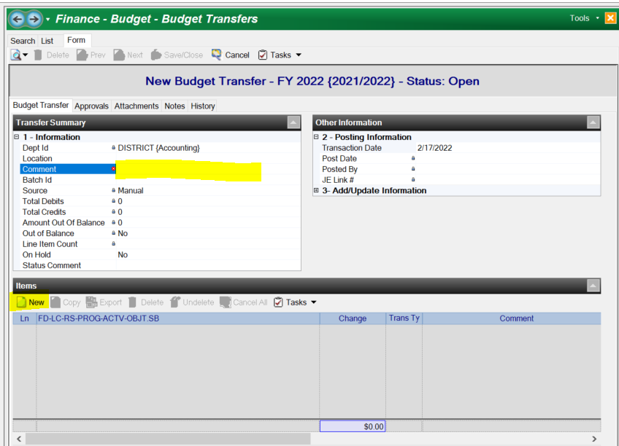
Budget Transfers - Transferring of funds from one object code to another - Transfers need to be within the same program. -Add in a comment that will assist in understanding the Transfer EX: Align Budget EX: Budget for Contract XZY EX: Spring 2022 Budget

Slide 28
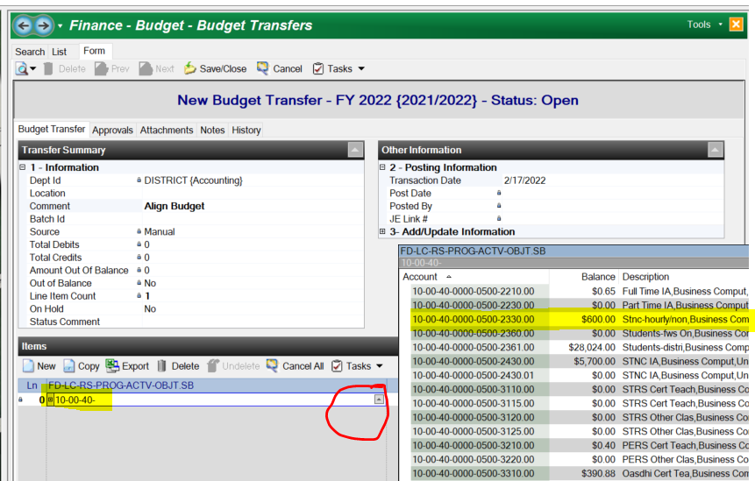
Budget Transfers - type in the budget code, you can enter in a portion and then select the Arrow -You can check the current balance from the Arrow - Budget Transfers must be within the same program

Slide 29
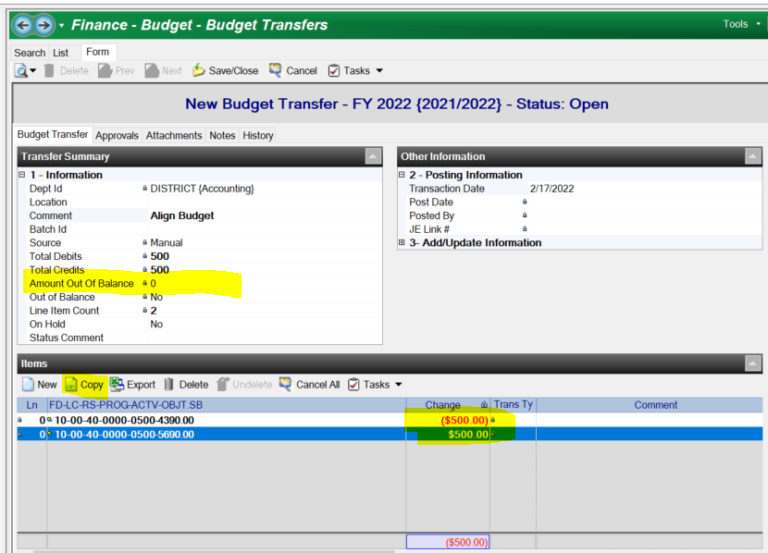
Budget Transfers - Negative for the decrease - Positive for the increase - budget increase must be the same program, in the example, the program is 0000. - Once complete, go up to Tasks and Submit

Slide 30
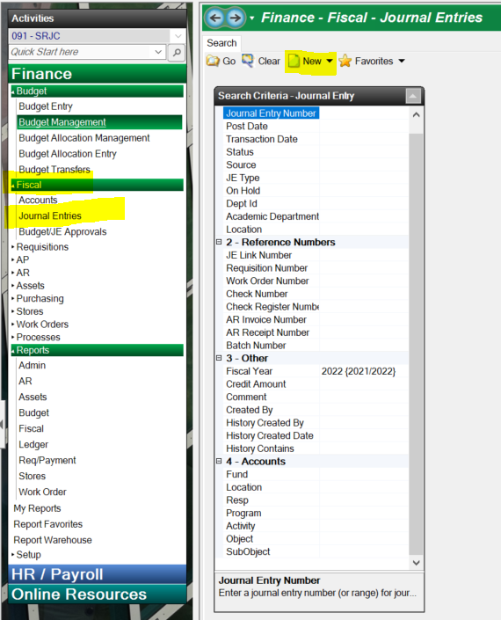
Journal Entries - Moving a posted expenditure from one program to another - ALL Journal entries, must have the same object code

Slide 31
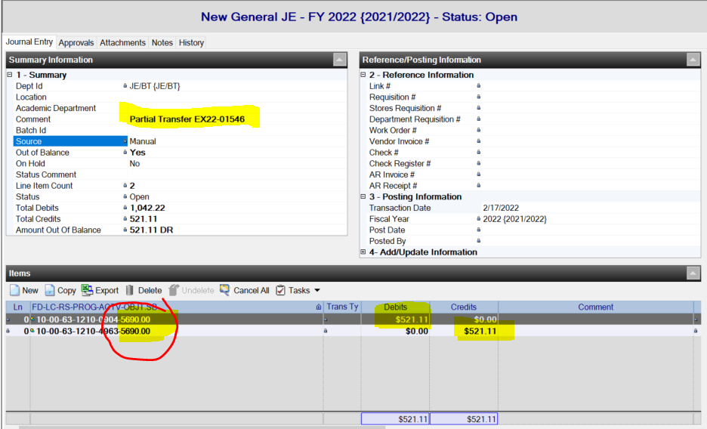
Journal Entries - Moving a posted expenditure from one program to another - Expenditures must be posted…not encumbered - ALL Journal entries, must have the same object code - Debit the Code you would like the expenditure to be charged too -Credit the code that the expenditure is currently charged too

Slide 32
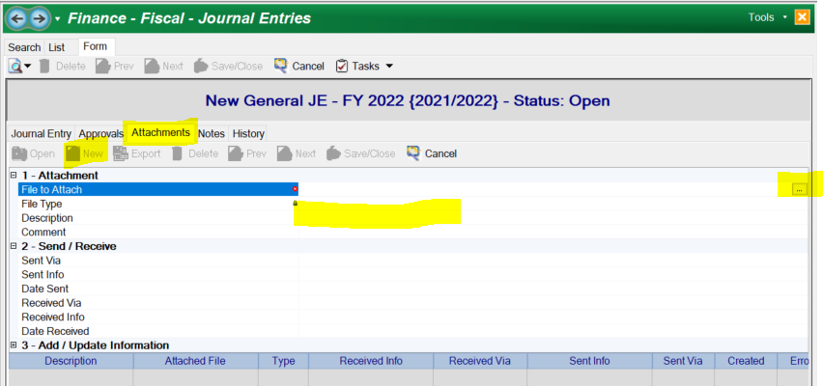
Journal Entries - Add the Fiscal 99 as an attachment in the attachments tab. -Save the Fiscal 99 as a PDF and highlight or note the expenditure you would like to transfer -Add a description “Fiscal 99” or “Ex22-01546” and any other back up attachments you would like to have on file - To submit, go to Tasks icon on top and Submit

Slide 33
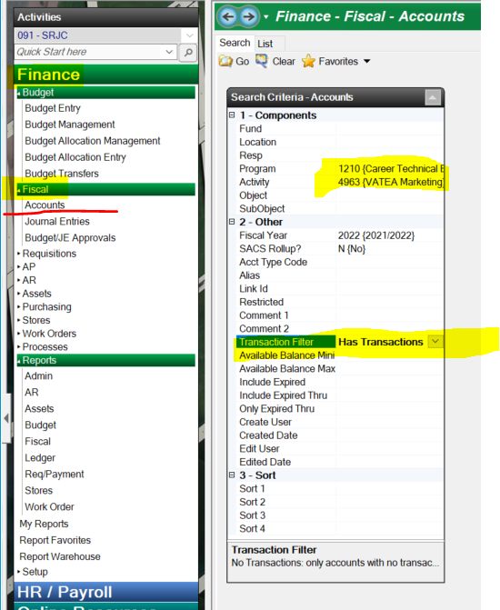
Fiscal 99 - Snapshot - Where do I find the Fiscal 99? -Under Finance, Fiscal, then Accounts - Type in some information in the components tab -Then hit the go button on top -Once you find the account, double click and it will produce the Fiscal 99 in a new window. You can also use a copy of the Fiscal 03 report if you prefer. - Pro Tip – use the “Has transactions” filter to only give you the accounts that have activity

Slide 34
Account Look up (Fiscal 99/Snapshot) - Check to see if you have a code - Remove “Has Transactions” Filter - If the code is not showing, please email the accountant for those programs Stephanie Dirks Sdirks@santarosa.edu for all Categorical/Restricted Programs (If the program code starts with a 1XXX) Shannon O'Reilly soreilly@santarosa.edu if the Program code does not start with a 1XXX Pro tip – Account codes without a budget or expenditures will not show up on a Fiscal repot. please check account look up for linked codes

Slide 35
Q&A
Any Questions?
Please email Stephanie at Sdirks@santarosa.edU if you have any questions.

