Slide 1
Categorical Fiscal Year End
Series: Tuesday Training
Presenter: Stephanie Dirks
Date: June 18, 2024

Slide 2
Presentation Notes:
This presentation is being recorded, please keep yourself on mute.
The link to the video presentation and the slides will be available.
Please hold all questions until the Q & A session, which will follow the formal presentation

Slide 3
Fiscal Year End Checklist & Guide
Budget development worksheets for the new fiscal year should be returned to Whitney Schultz in Accounting (for unrestricted accounts) or to Stephanie Dirks (for grants and categorical programs) by the first Friday in May.
For Grant and Categorical Programs (1XXX programs) you will have an opportunity in June/July to make changes/updates to the Tentative Budget for the Adopted Budget.

Slide 4
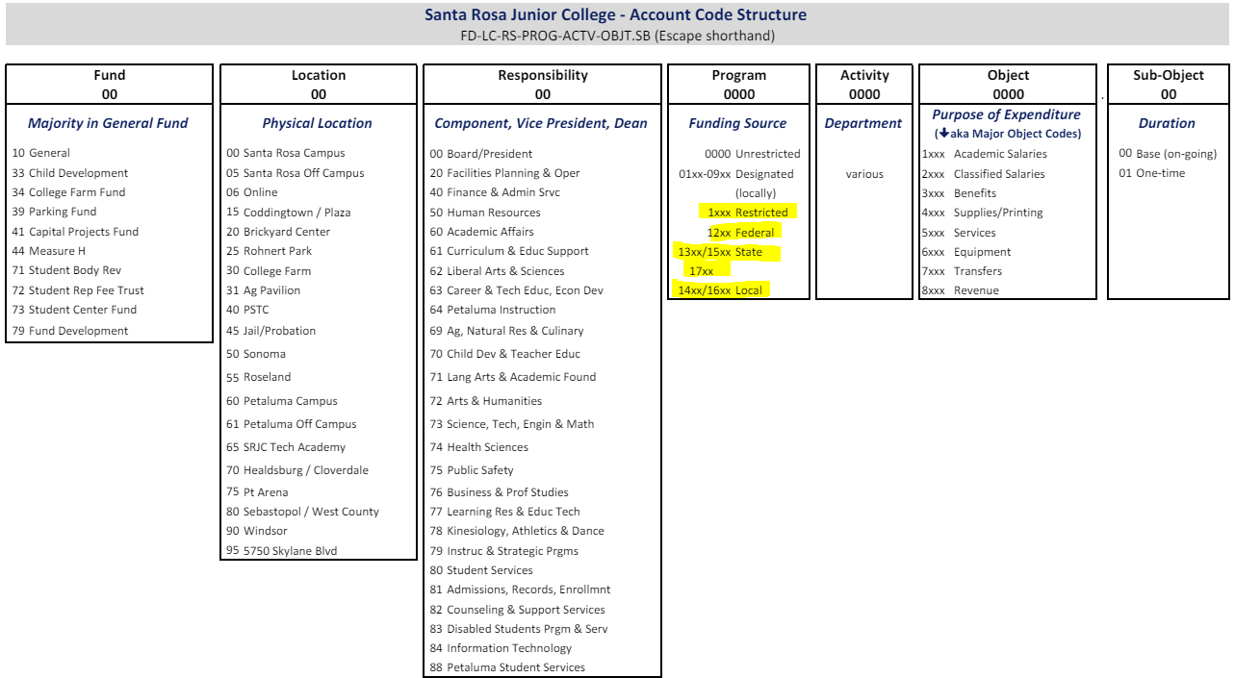
Chart of Accounts

Slide 5
Budget
Final budget transfers for the fiscal year should be submitted by June 30, but no later than July 12 (often we are back-dating transactions and cleaning up accounts in July following the end of the fiscal year). When submitting budget transfers in July, make sure you select the correct fiscal year from the drop-down. Budget transfers are used to transfer allocations.
Final journals (start on page 7) for the fiscal year should be submitted by June 30, but no later than July 12 (often we are back-dating transactions and cleaning up accounts in July following the end of the fiscal year). When submitting journals in July, make sure you select the correct fiscal year from the drop-down. Journals are used to transfer expenditures.
Payroll adjustments/corrections are entered by Payroll based on PAF revisions submitted by the department.
*Additional Resources – Tuesday Training & Past Accounting Training Video Links

Slide 6
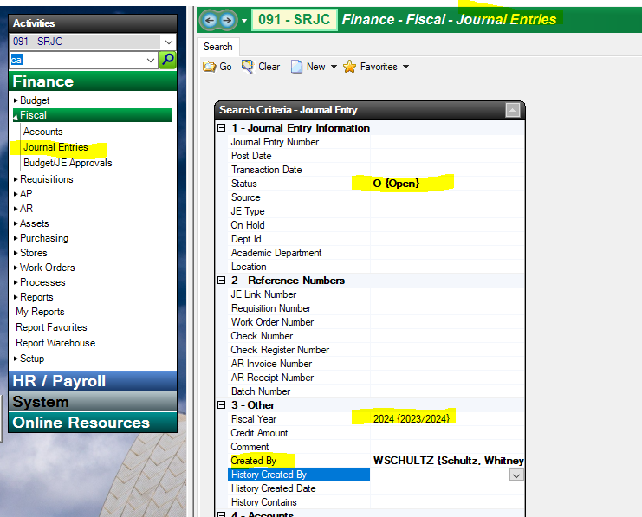
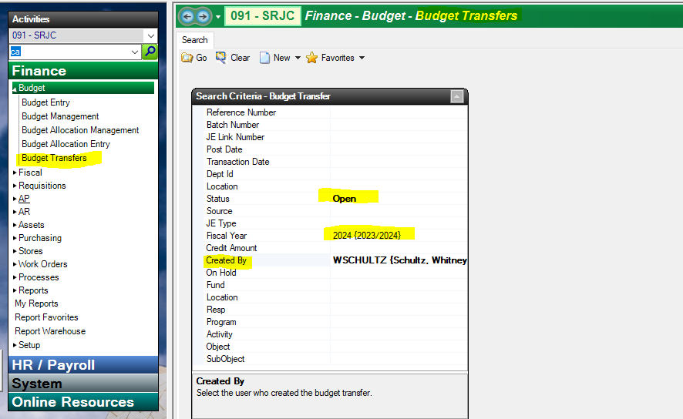
Budget
Search budget transfers and journals with “Open” status; sometimes a transfer or journal is started but never completed. Submit valid items and delete ones that are no longer needed. Search parameters: “Status” = Open, “Created By” = your user ID:

Slide 7
Budget
If your budget code is changing in the new fiscal year (responsibility code changes, for example), please change templates and other reference documentation as necessary so that new fiscal year forms are submitted correctly.
New fiscal year budgets are available for viewing in Escape after the June board meeting. The Tentative Budget is approved in June and the Adopted Budget is approved in September.
For carryover accounts such as trusts and categorical programs, it usually takes until the end of July before we have final year-end figures to carry forward.

Slide 8
Accounts Receivable
All billing/invoicing on behalf of the district must be done by Debbie Weatherly in Accounting. Contact Debbie if you have any invoices that need to be prepared, this will ensure that your account gets credit for any funds due. Include the budget code, dollar amount, description of item and whom to bill.
Any payments, refunds or reimbursements to the district (for example a vendor refund) should be submitted to Debbie Weatherly in Accounting by June 16 to make the end-of-year cutoff. After June 17, notify Debbie of any expected funds so that she can set-up an accounts receivable; this will ensure that your account gets credit in the old fiscal year even if the payment is received after July 1. Forward any payments that you receive to Debbie ASAP.
For reimbursements to a district account from the Foundation, submit Request for Disbursement forms to the Foundation no later than June 7 to be included in the final Foundation check run for the fiscal year (always ideal). Deadline for submitting Request for Disbursement forms is July 12. Always include the district account that you would like the funds deposited into on the form.

Slide 9
Accounts Payable
Vendor Invoices submit all to Accounting ASAP after getting approval signatures. Invoices submitted by June 7 will be included in the final check run for the fiscal year (always ideal). Invoices submitted afterwards will be paid in July when payments resume. Include the PO# on invoices if not already provided by the vendor.
Payment Request Forms submit to Accounting by June 7 to be included in the final check run for the fiscal year (always ideal). Deadline for submitting Payment Request forms is July 12. Note “Liability” on forms that are submitted in July for purchases made through 6/30. We use the term “Liability” when we are making a payment in the new fiscal year but need to post the charge to the old fiscal year.

Slide 10
Accounts Payable
Mileage Reimbursements must be submitted and approved in Escape (as Employee Payments) by June 7 to be included in the final check run for the fiscal year (always ideal). Deadline for submitting mileage reimbursements is July 12. When submitting June mileage reimbursements in July, make sure you select the old fiscal year from the drop-down.
Employee Reimbursements must be submitted and approved in Escape (as Employee Payments) by June 7 to be included in the final check run for the fiscal year (always ideal). Deadline for submitting employee reimbursements is July 12. When submitting employee reimbursements in July for purchases made in June, make sure you select the old fiscal year from the drop-down. This would include uniform allowances and reimbursements for miscellaneous purchases under $200.
Staff Travel Expense Claims submit to Accounting by June 7 to be included in the final check run for the fiscal year (always ideal) or as soon as possible after the trip. For travel late in June, submit the Travel Expense Claim to Accounting by July 12. Even if the trip was cancelled or no additional reimbursement is due, you must submit a Travel Expense Claim for zero dollars so that we may close out the trip.
Student Travel Forms submit to Accounting by June 7 to be included in the final check run for the fiscal year (always ideal) or as soon as possible after the trip. For travel late in June, submit the Student Travel Form to Accounting by July 12. Even if the trip was cancelled or no additional reimbursement is due, you must submit a Student Travel Form for zero dollars so that we may close out the trip.

Slide 11
Accounts Payable
Final Cash Advance Receipts submit final and/or remaining cash to Accounting by June 7 (ideal) or no later than July 12. Include a tally of the receipts; subtract this total from the initial cash advance amount to determine the amount of cash to be returned, if any.
Office Depot packing slips submit to Accounting by June 7. Final Office Depot orders should be placed no later than June 2 to allow time for processing.
CalCard Expense Reports submit in Chrome River for purchases listed on the June 7th statement no later than June 7. Final CalCard purchases should be made before June 20 to allow time for purchases to be received by June 30. Submit CalCard expense reports in Chrome River for purchases listed on the July 7th statement no later than July 10. Cal Cards may not be used between June 21st – July 7th.
Bulk mail charges at the end of June will appear on the July statement from the vendor and will be charged to the new fiscal year. If you are a Categorical Program and the charge needs to be a liability to the prior fiscal year, reach out to Stephanie Dirks prior to July 12th.

Slide 12
Requisitions / Purchase Orders
Review the Purchasing Deadline memo that is distributed in spring; submit all requisitions by the stated deadlines to ensure that items are received prior to June 30.
Some items need additional delivery lead times or may require quotes/bidding. Items received after June 30 will be charged to the new fiscal year. No exceptions.
Standard practice is to check fund availability and wait for any budget transfers to be processed/posted before submitting a requisition. Only in emergency situations should you submit a requisition with insufficient funds.
When submitting a requisition with insufficient funds, either 1) process a budget transfer to cover the cost and include the budget transfer number in the Notes section of the requisition, or 2) email the buyer and include Whitney Schultz or Stephanie Dirks (for grants and categorical programs) on the email, explaining why you need approval to process the requisition with insufficient funds. Whitney or Stephanie will confirm approval with the buyer.

Slide 13
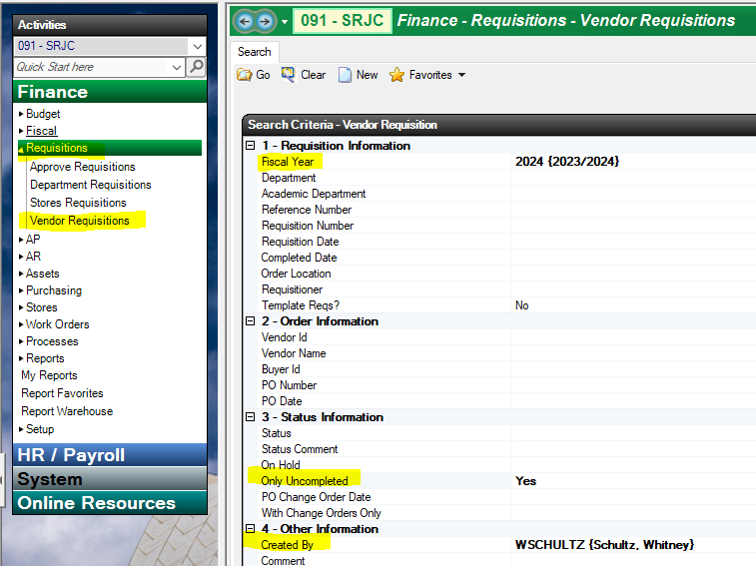
Requisitions / Purchase Orders
Review all outstanding requisitions on a regular basis. There is no need to wait until year-end; for example, semester-based requisitions should be reviewed at the end of the semester. For requisitions that are complete and all invoices have been paid, notify Nicole O’Brien in Accounting that the purchase order can be completed (closed). This allows any remaining balances to be disencumbered and the funds made available in the account.
After the final check run for the fiscal year has processed on June 12th, run a search of all vendor requisitions that are “uncompleted” as shown in the screen shot. Search parameters: include fiscal year, “Only Uncompleted” = Yes, “Created By” = your user ID.

Slide 14
Requisitions / Purchase Orders
Review each requisition to determine the year-end status; there are three possibilities:
Complete – all items have been received and all invoices have been paid in full (as shown on the Payments tab of the requisition). These requisitions will be closed; any remaining balances will be disencumbered and the funds made available in the account.
Liability – all items have been received prior to June 30, but final payment has not yet been made (usually because we are waiting for an invoice). These requisitions will be charged to the old fiscal year and invoices will be paid when submitted to Accounting.
Rollover – all items have not been received by June 30. These requisitions will be disencumbered in the old fiscal year and encumbered in the new fiscal year. Items and/or services received on or after July 1 MUST be charged to the new fiscal year. No exceptions.
Email Nicole O’Brien in accounting a list of requisitions and their status (using the three possibilities listed above) no later than July 12.
New fiscal year requisitions can be entered in Escape beginning May 17. You can copy requisitions from one year to the next; be sure to update pertinent information as applicable prior to submitting. New fiscal year requisitions will not be processed by Purchasing until July 1.

Slide 15
Timesheets & PAFs
Contact employees within your department to ensure that final timesheets for the fiscal year are turned in on time. This is critical as late timesheets will be charged to the new fiscal year, reducing what you will have available to spend.
June 9th for STNC and student timesheets (pay period May 10 – June 9)
June 20th for Associate Faculty timesheets (pay period May 21 – Jun 20)
Timesheets for pay periods beginning June 10 (STNC and student) and June 21 (Associate Faculty) will be charged to the new fiscal year.
EXCEPTION: for categorical programs requiring Payroll Liabilities, timesheets through June 30 must be turned in on June 28th by noon to Payroll to be included on the July 10 payroll. See additional information under Grants & Categorical Programs.
Review PAFs on a regular basis. There is no need to wait until year-end; for example, semester based PAFs should be reviewed at the end of the semester. Notify Shannon O’Reilly in Accounting (for unrestricted accounts) or Stephanie Dirks (for grants and categorical programs) if any PAFs can be disencumbered. Include the PAF #, budget code and amount to disencumber in your email. All PAFs will be automatically disencumbered after the July 10 payroll is posted, but disencumbering PAFs sooner will free up funds in the account.

Slide 16
Timesheets & PAFs
If payroll charges are required a revised budget code change PAF should be routed and signed.
If your budget codes are changing in the new fiscal year (RS code changes, for example), please change PAF templates and other reference documentation as necessary so that new fiscal year PAFs are submitted correctly.
There is no need to wait until July 1 to submit new fiscal year PAFs, you can begin submitting PAFs in the spring. Make sure to note the correct fiscal year and budget code on the PAFs. To coincide with the pay periods, STNC PAFs for the new fiscal year begin on or after June 10th and Associate Faculty PAFs for the new fiscal year begin on or after June 21. For permanent management and classified staff, submit PAF changes for the new fiscal year by July 1st to ensure that the July payroll is charged correctly. For contract faculty, submit PAF changes for the new fiscal year prior to August 1st to ensure that the August payroll is charged correctly.
For adjunct PAFs that straddle the fiscal years, include in the Remarks field an explanation of how many hours or dollars are being charged to each pay period. For example:
May 21 – June 20 = 15 hours / June 21 – July 20 = 20 hours

Slide 17
Grants & Categorical Programs
In general, grants and categorical programs would follow the same year-end process and deadlines as described above, with additional considerations noted below. Grant reporting deadlines vary so be sure to check the dates that apply to your program.
Program allocations may change throughout the fiscal year. In early May, confirm that the revenue budgeted in Escape matches your program allocation and if not, submit a Budget Increase/Decrease form to Stephanie Dirks in Accounting no later than May 13 (to make the cutoff for Board approval in June). This does not have to wait until fiscal year-end; monitor your budget throughout the year and submit Budget Increase/Decrease forms as needed.

Slide 18
Grants & Categorical Programs
Payroll Liabilities
ONLY a handful of 1XXX and Bill Back Accounts →

Slide 19
Grants & Categorical Programs
The timesheets for June work are called Payroll Liabilities and are submitted to Payroll on June 30 to be included on the July 10 payroll. The timesheets for July work are turned in at the end of the pay period as usual.
 |  | Pay Period | Due to Payroll
STNCs and students | Timesheet #1 (June) | June 10 – June 30 | By noon on June 28
 | Timesheet #2 (July) | July 1 – July 9 | July 10
Adjunct | Timesheet #1 (June) | June 21 – June 30 | By noon on June 28
 | Timesheet #2 (July) | July 1 – July 20 | July 22

Slide 20
Grants & Categorical Programs
As the details for each program vary, program managers and/or support staff should make an appointment with Stephanie Dirks in June to review specific closeout procedures and timelines.
Grants and categorical programs that end on June 30 should plan to have all funds expended no later than July 31. If your program extends beyond June 30, carryover balances and new fiscal year budgets need to be determined and set-up shortly after July 31.
The Adopted budget for the new fiscal year is presented to the Board of Trustees for approval at the September meeting. Review the budget figures in Escape one last time in mid-August to ensure that the new fiscal year programs (or carryover amounts from the prior fiscal year, if applicable) are correct. Contact Stephanie Dirks for any budget changes/corrections.

Slide 21
Miscellaneous
Prepaid expenses are payments that need to occur in one fiscal year, even though the event, services or items will not be realized until the next fiscal year. For example, you may need to pay for a registration advance in May for a conference you are attending in August. When this occurs, you will need to use the following prepayment account on your requisition, employee payment or travel form: 10-00-00-0000-0000-9220.00. This allows us to make the payment now, but the charge will be posted in the new fiscal year. Please include a note stating which department budget code this should be charged to in the new year.

Slide 22
Updated Information for 2025 Fiscal Year
Please review the Memo: Budget Code Changes Effective 7/1/2024
Staring July 1st, 2024, all former “mirror accounts” (foundation accounts that have a categorical program number) will be called Bill Back Accounts, and they will have a new program number of 03XX.

Slide 23
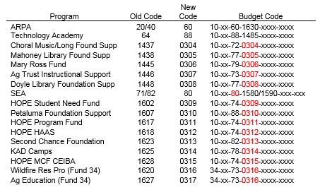
Budget Code Changes Effective 7/1/2024

Slide 24
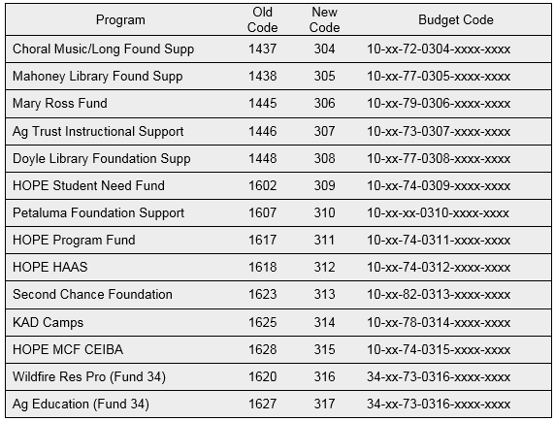
Foundation Bill Back Accounts
Staring July 1st, 2024, all former “mirror accounts” (foundation accounts that have a categorical program number) will be called Bill Back Accounts, and they will have a new program number of 03XX.
Please note that moving forward there will not be any budget on the Categorical/District side. All expenditures will be charged to the budget codes (as normal), accounting will invoice the foundation, and the foundation will reimburse the expenditures. At the end of the year, it will show $0.00 in expenditures, and $0.00 in revenue. Please keep internal records allowing your program to know the current foundation balances available.
Please make necessary changes to all of your internal documents to reflect these new program numbers for the 2025 Fiscal Year. Any current PAFs in the system/or that have been submitted will be updated when the Accounting System (Escape) is updated as of June 1st. Any new PAFs submitted (after June 1st) will need to reference the new program code.

Slide 25
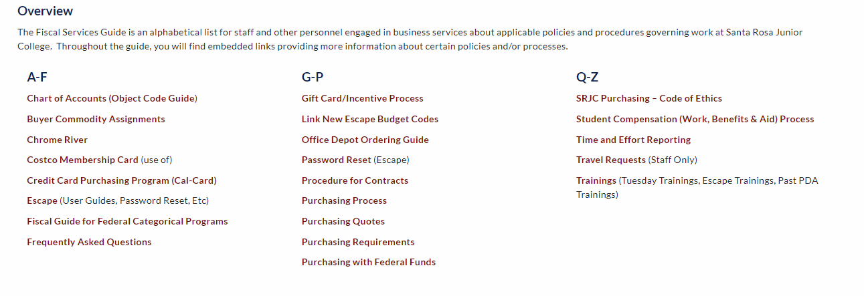
Additional Resources
Fiscal Services Guide

Slide 26
Questions?

